Slide 1



Cinematic Studies
Introduction

Slide 2
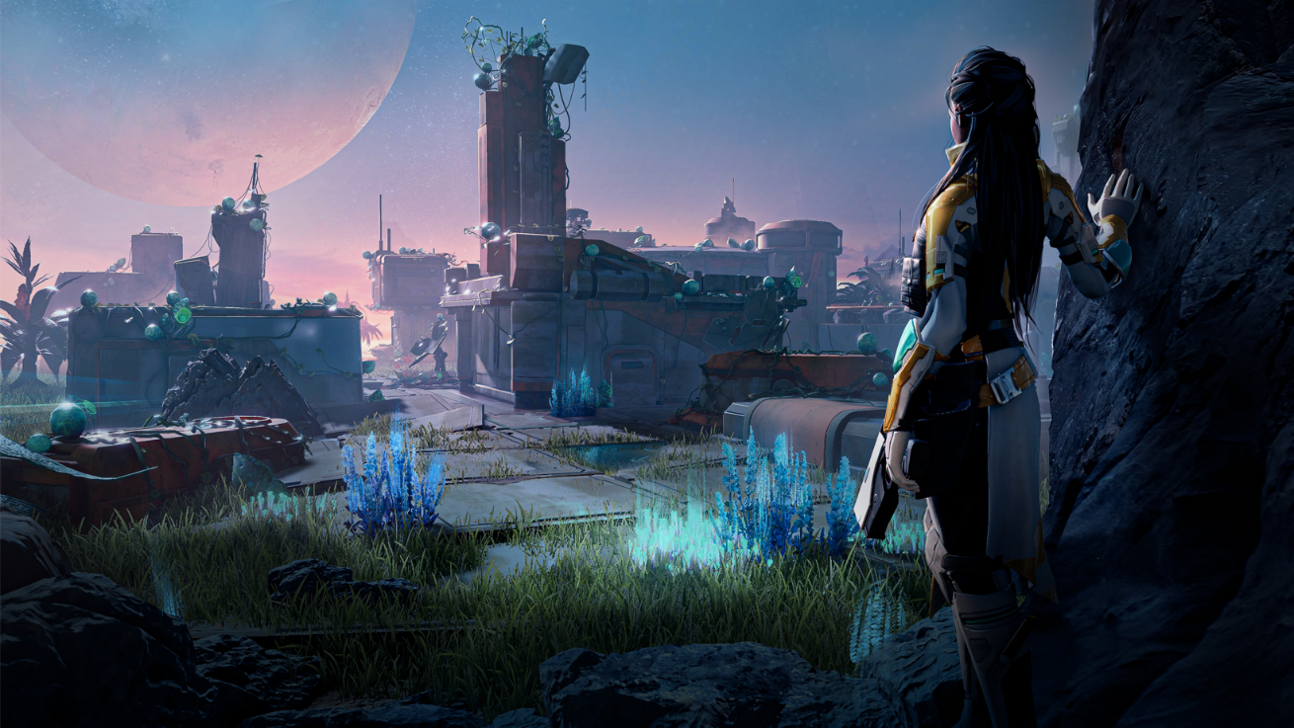
Class overview
Personal Introduction
Cinematic Studies - Course Overview
Cinematic Studies - Course Assignments & Grading
Q&A

Slide 3
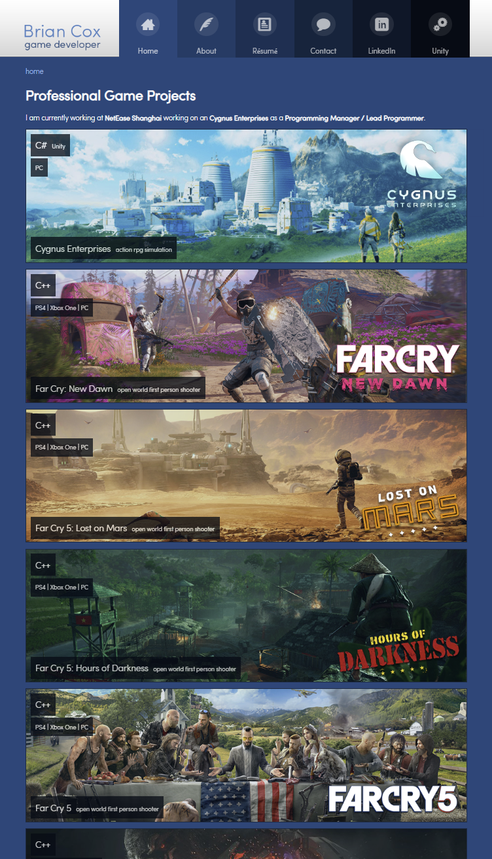
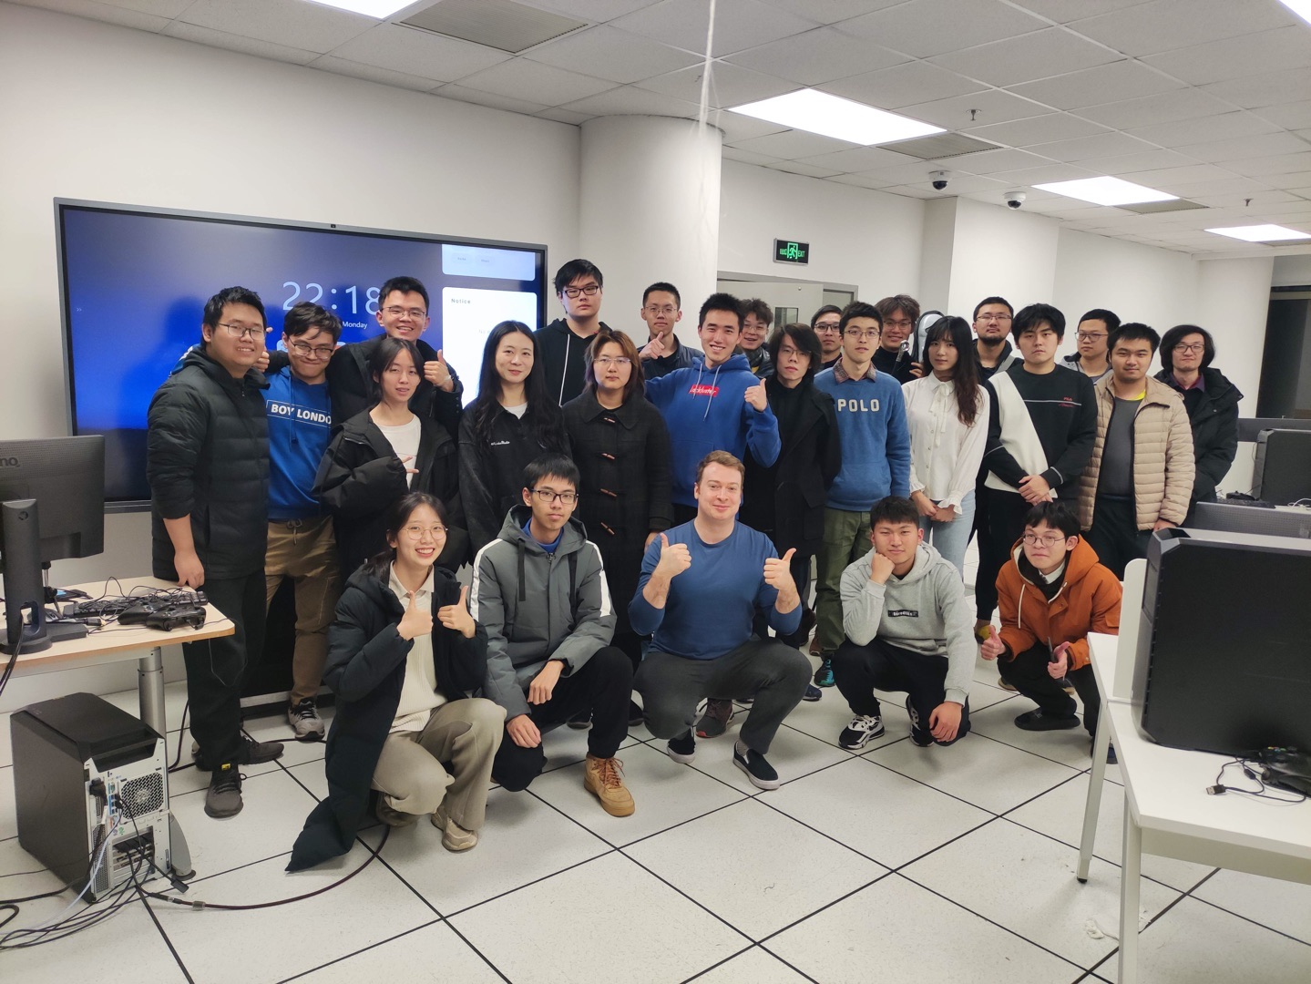
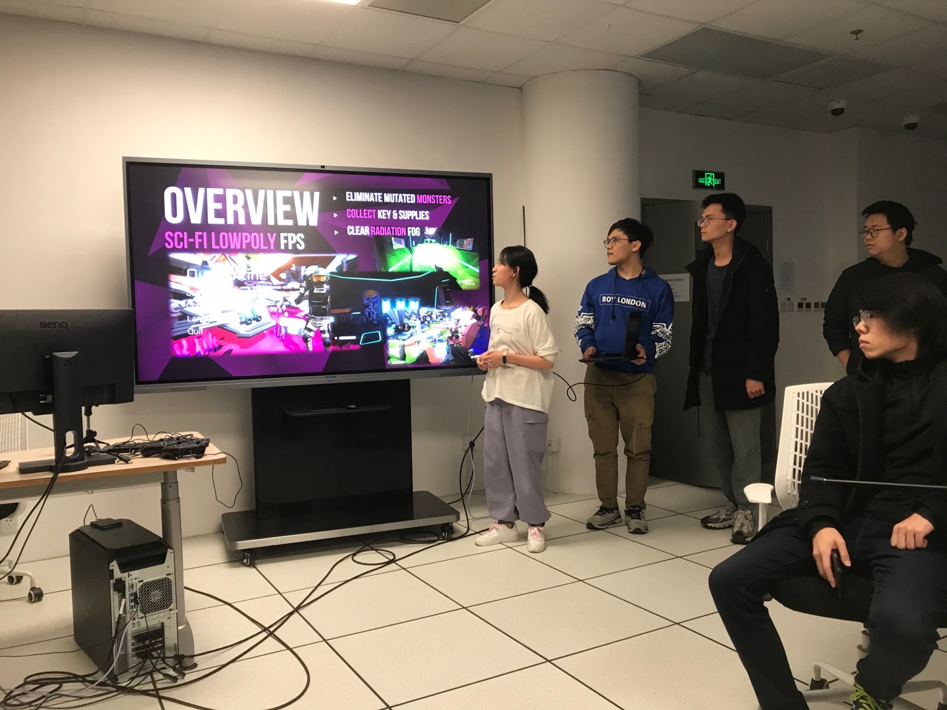
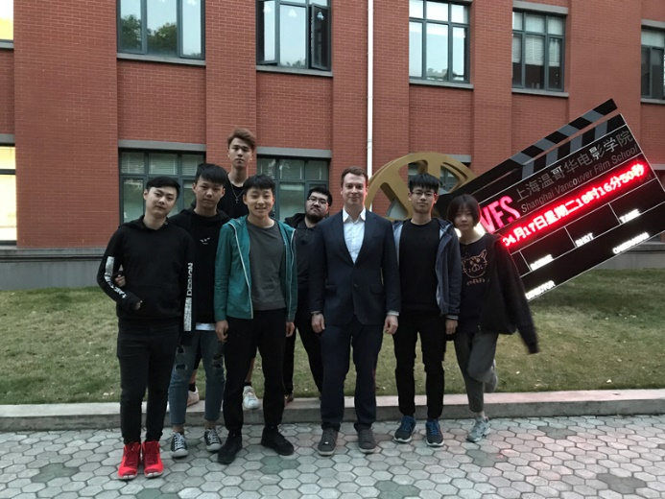
Personal Introduction
Lead Programmer / Programming Manager @ NetEase Shanghai X23
10+ years experience, 8+ AAA Games, 3+ AA Games, 5 Top Studios
Developing: AAA games using C++, Indie Games in Unity using C#
Lecturing C# and Unity at Universities (ShanghaiTech & SHVFS)
https://www.briancox.be

Slide 4


















Personal Introduction - Experience
2013 Age of Wonders III – Intern → UI & Gameplay Programmer [Gameplay, UI, Tools]
2013 – 2014 Kinect Sports Rivals → UI Programmer [UI]
2015 Rare Replay → Main UI Programmer [UI, Flash, Team Management]
2016 Sea of Thieves → Gameplay Programmer II [Gameplay, Network, Prototyping, Perf. Opt.]
2016 – 2017 Halo Wars II → UI Programmer [UI, Networking]
2017 – 2018 Far Cry 5 DLCs → UI Programmer [UI]
2017 – 2019 Far Cry New Dawn → Senior UI Programmer [UI, Network, Gameplay]
2019 – now Cygnus → Lead Programmer / Programming Manager [Gameplay, Team Management, Design]

Slide 5
Course Overview
Creating and Navigating a 3D environment in preparation for a Digital Movie Set
  Object Creation & Placement in 3D space
  Moving, Rotating and Scaling objects
  Project resources & Scene Management
  Adding components to objects
  Creating Materials
Creating atmosphere using Lighting
  Adding lights to our 3D scene (Omni light, Directional Light, ...)
Implementing Custom Art in a Digital Movie Set
  Importing Textures, 3D models, animations, audio effects, music, …

Slide 6
Course Overview
Creating a digital Camera Sequence
  Transitions between digital Cameras
Adding feeling & emotions through Sound & Music
Setting the tone and atmosphere of the movie
  Adding Visual Effects & Particles to a Scene
  Controlling the tone and mood using Post-Processing
Material setup and variations in render quality
Shaders
  Implementing custom shader effects

Slide 7
Course Overview
Adding Animated Characters to a scene
  Static posed characters
  Fully animated characters
  Animation Blending
  Setting up an Animation Tree
RootMotion Animations & Animation Sequence Setup
Inverse Kinematics for precise animation handling
  Characters holding weapons or objects
Using animation events to trigger follow up Actions

Slide 8
Course Overview
Adding 3D text and UI elements in the World & UI
Video inception
  Playing videos within our Digital scene

Slide 9
Course Assignments & Grading
Assignment 1 – “Frozen in Time” Cinematic – Week 4 – 20/100
  Architectural or landscape setting with multiple cameras and camera transitions.
  Characters are not animated and are using poses (if characters are present in the scene)
Assignment 2 – Animated Cinematic – Week 8 – 20/10
  A scene which has both environmental setup as well as animated characters and elements in the background.
Assignment 3 - Block-Out of Final Assignment – Week 12 – 20/100
  Demonstrate the scene build up and camera settings of your final project (without need for visual effects & polish)
Final Project – Final Cinematic - Week 16 – 40/100
  Using every technique learned in the course creating a cinematic sequence which has animated characters, post-processing, visual effects, sound effects and able to showcase a fully polished cinematic video.

Slide 10
Q&A
Do you have any questions related to the topics mentioned?
Any topics you would like to see specifically?

