Slide 1
Cinematic Studies
Creating and Navigating a 3D environment in preparation for a Digital Movie Set

Slide 2
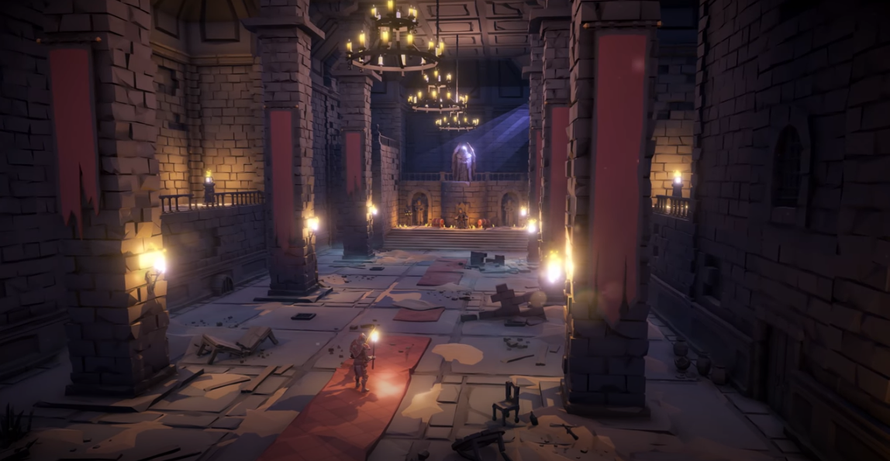
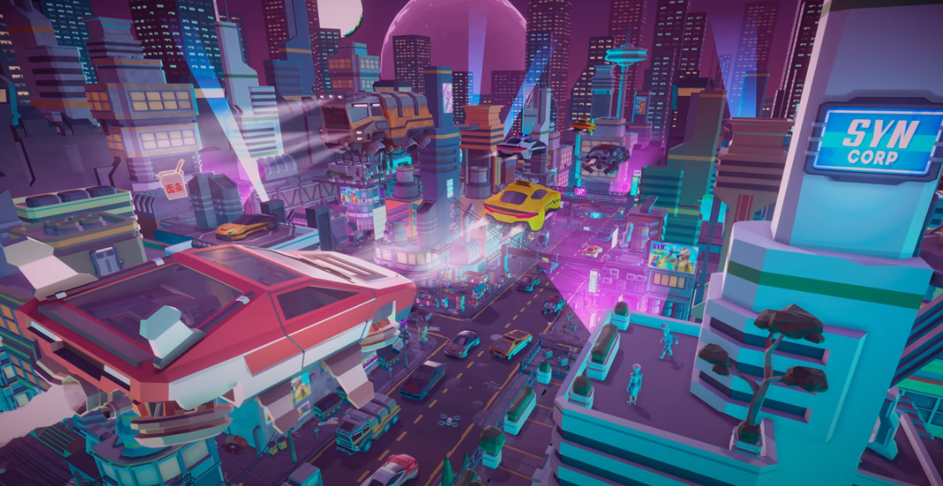
Class overview
Unity User Interface
Object Creation & Placement in 3D space
Moving, Rotating and Scaling objects
Creating atmosphere using Lighting
Creating Materials
Project resources & Scene Management
Importing Custom Assets (Textures, 3D models, …)
Adding Ambiance and Music to your Scene
Prefabs
Setting up characters for static posing
Getting animations from Mixamo!
Precise asset placement using Bones

Slide 3
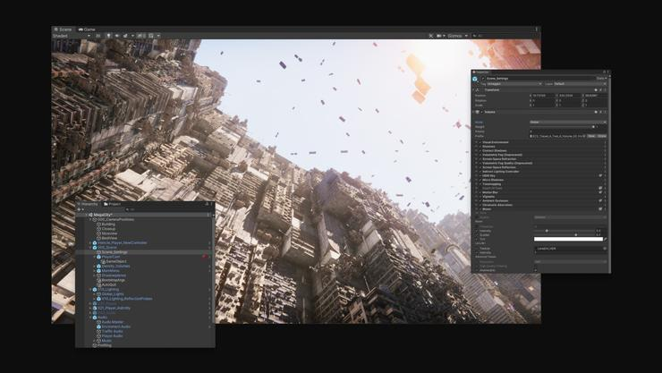
Unity User Interface
Creating 3D Objects
Move, Rotate, Scale
Inspector Window & Scene Hierarchy
Adding components
Creating Materials

Slide 4
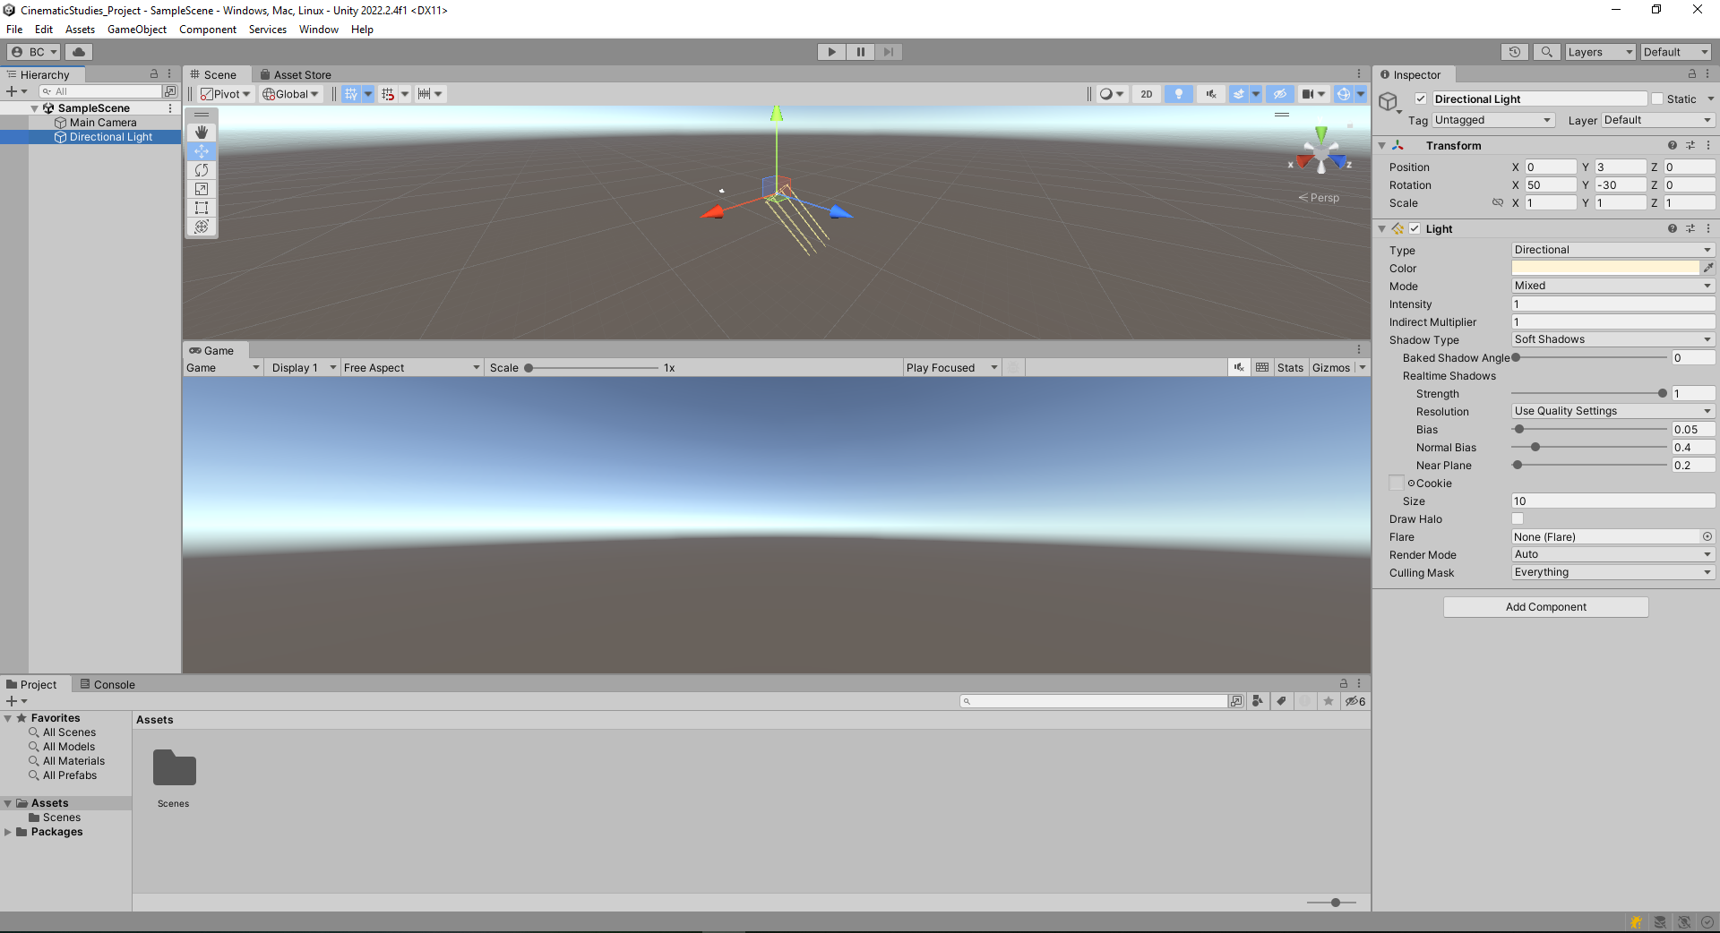
2. Scene View
1. Scene Hierarchy
3. Inspector Window
4. Project Window
5. Game View

Slide 5
3. Application Actions
1. Tools
2. Selected Object Axis
4. Active Axis

Slide 6
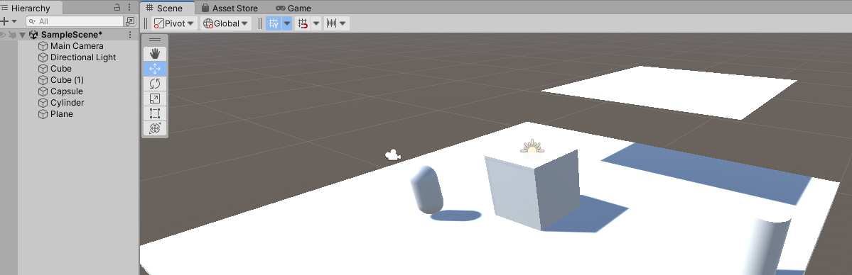
Object Creation & Placement in 3D space
Create a combination of Primitive 3D Objects
Cube, Sphere, Cylinder, Plane, …
Place them in the 3D scene
Navigate the 3D space by using Panning, Zooming and Rotating the Camera
Learn the difference between Editor view & Game view

Slide 7
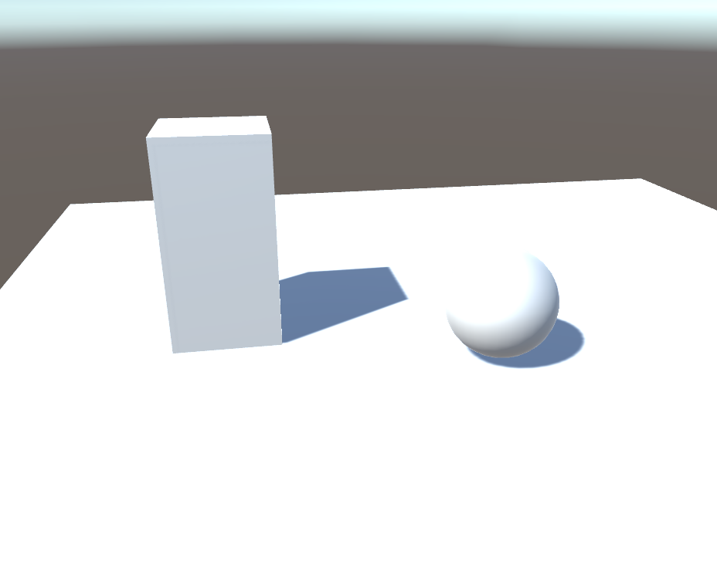
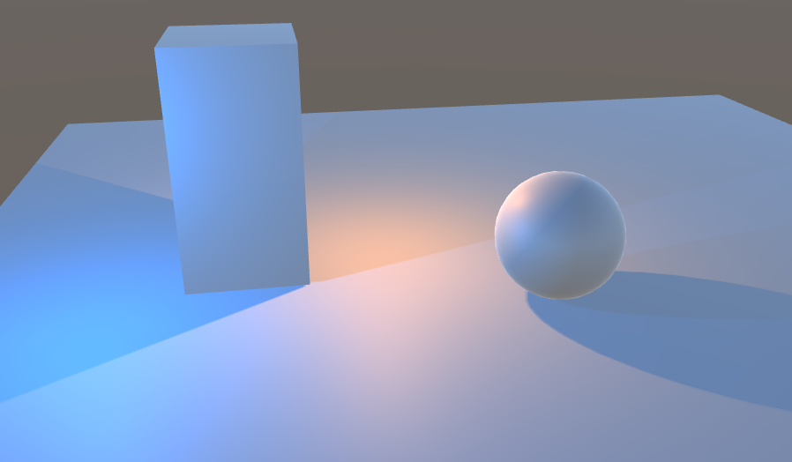
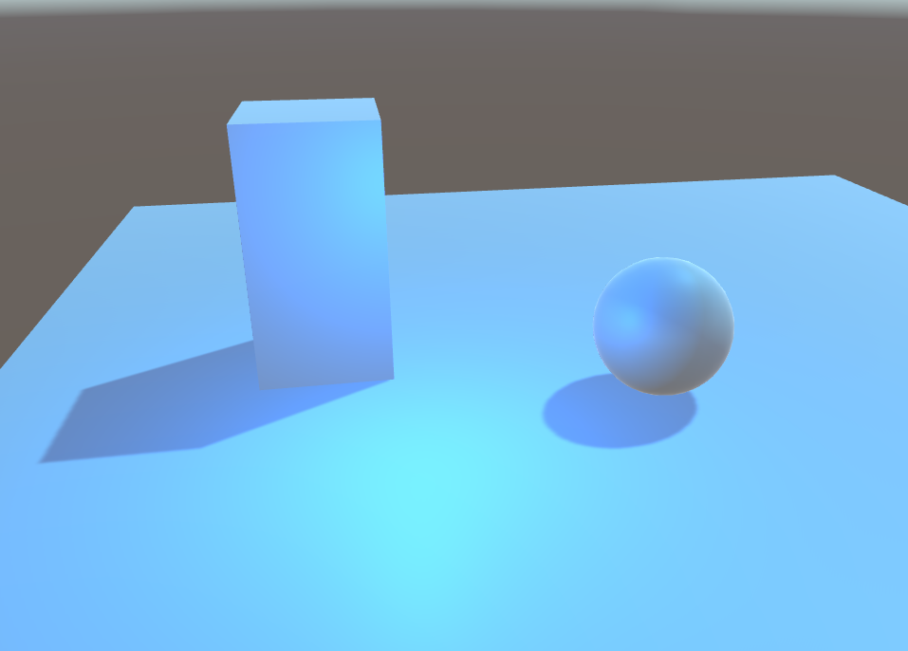
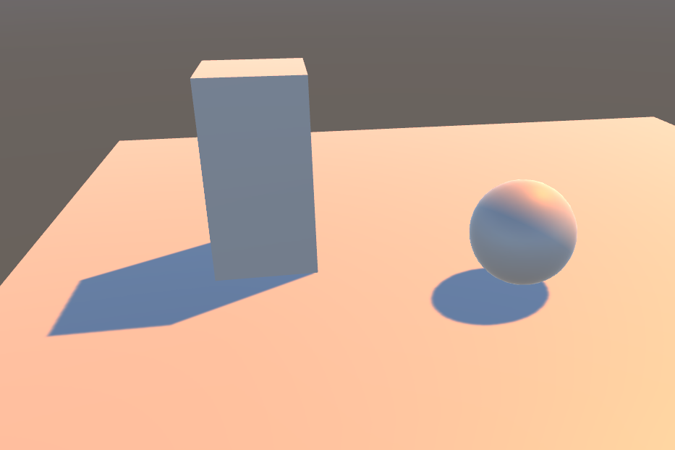
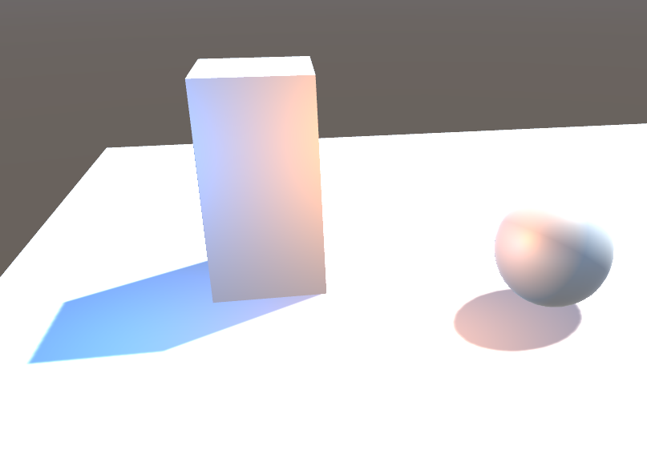
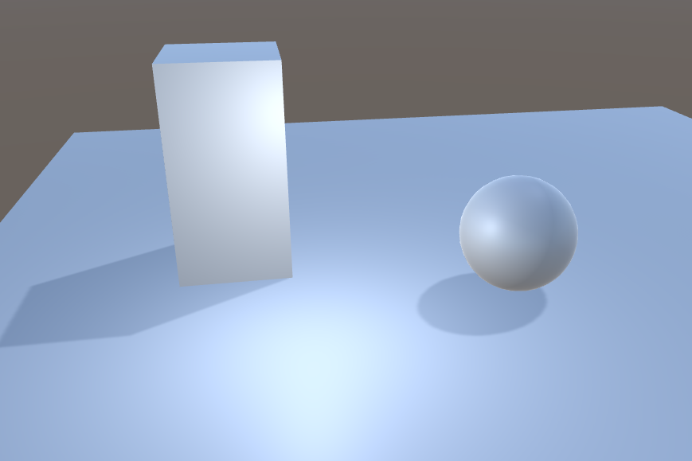
Creating atmosphere using Lighting
Add lights to our 3D scene (Omni light, Directional Light, ...)

Slide 8
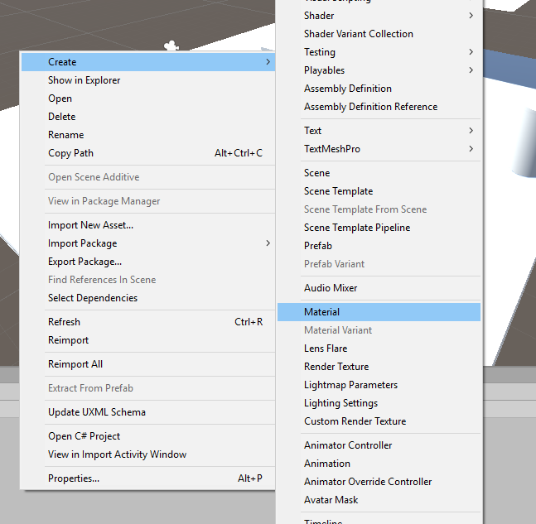
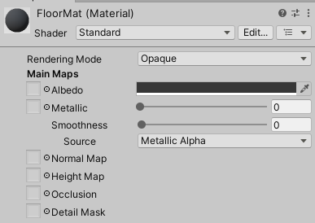
Creating Materials
Create and assign Materials to several objects in the scene
Experiment with different types of Materials
Make a transparent material
Make a reflective material
Shaders will be explained later :)

Slide 9
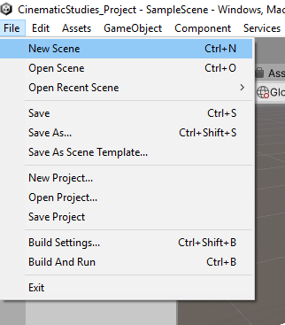
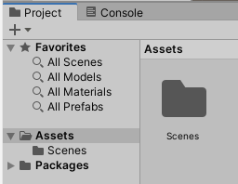
Project resources & Scene Management
Save the Scene
Create a new Scene
Create a new Material
Import custom assets

Slide 10
Importing Custom Assets
Import Textures, 3D models, animations, audio effects, music, …
Choose the Dungeon or Sci Fi Asset Pack

Slide 11
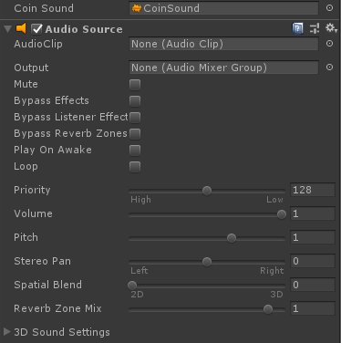
Adding Ambiance and Music to your Scene
Playing sounds / Music using AudioSource and AudioClips

Slide 12
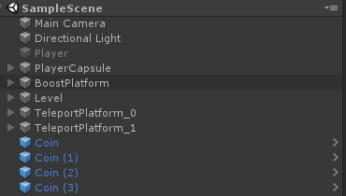
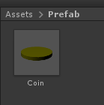
Prefabs
Creating assets for instancing and updating scene

Slide 13
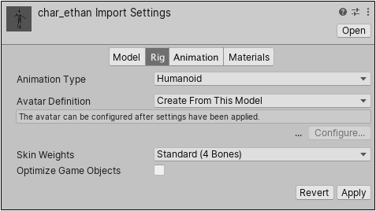
Setting up characters for static posing
Find Character Prefab and 3D model
Setup Character model to reveal bones (change setting in rig)
Off

Slide 14
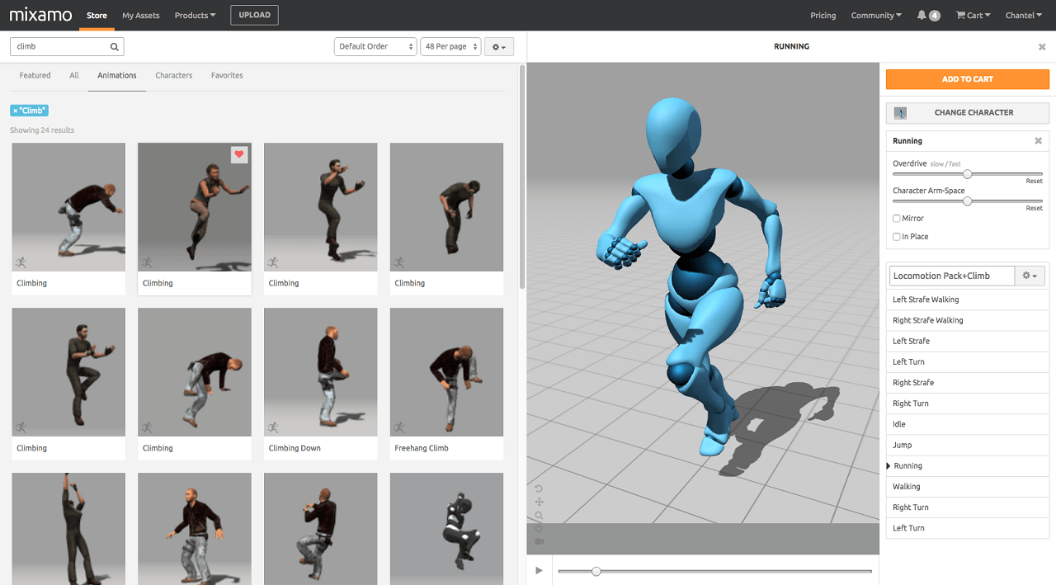
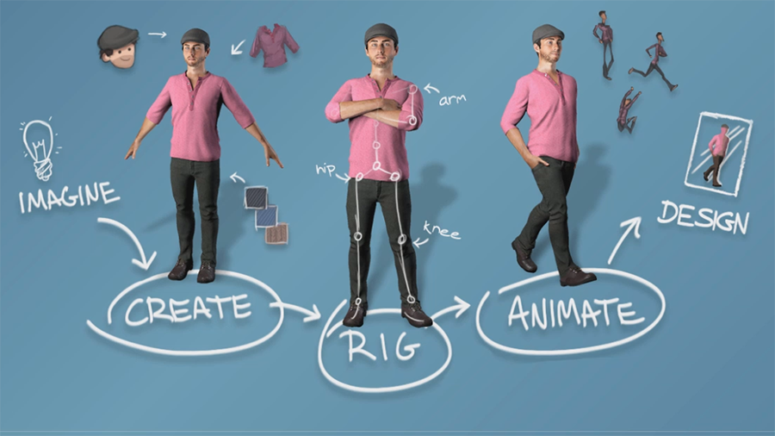
Getting animations from Mixamo!
Go to www.mixamo.com
Create an Adobe Account
Upload your character or download an existing one
Choose an animation
Download and import animation

Slide 15
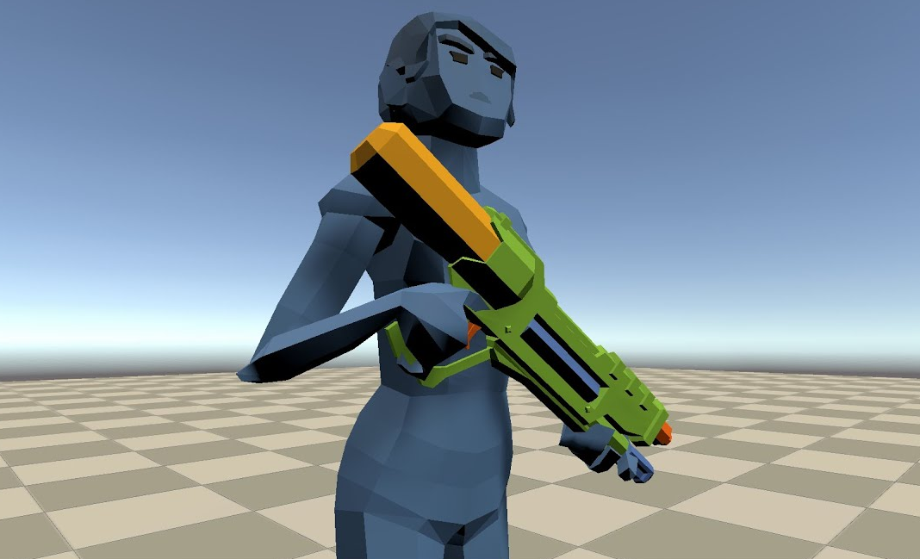
Precise asset placement using Bones
Find an asset like a weapon you would like the character to hold
Find the left hand or right hand bone
Place the Asset in the hand of the character
Tweak and improve the positioning
Check the character pose

Slide 16
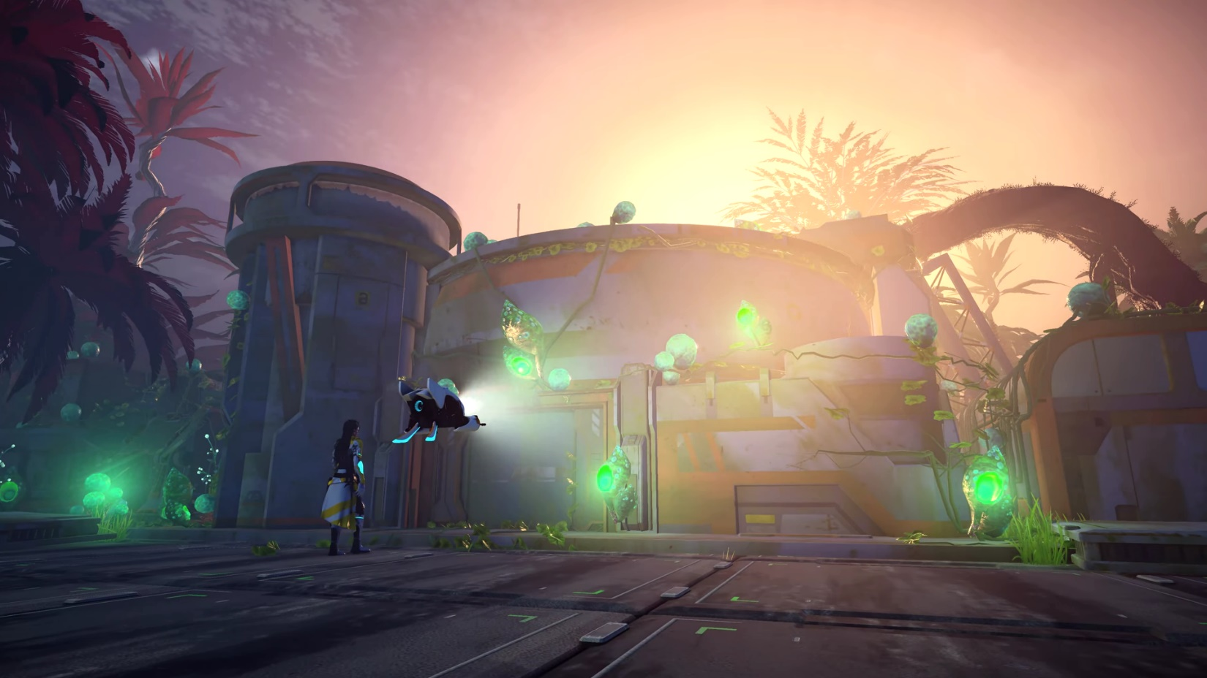
Q&A
Do you have any questions related to the topics mentioned?

