Slide 1
Cinematic Studies
Timeline & Workflow improvements

Slide 2
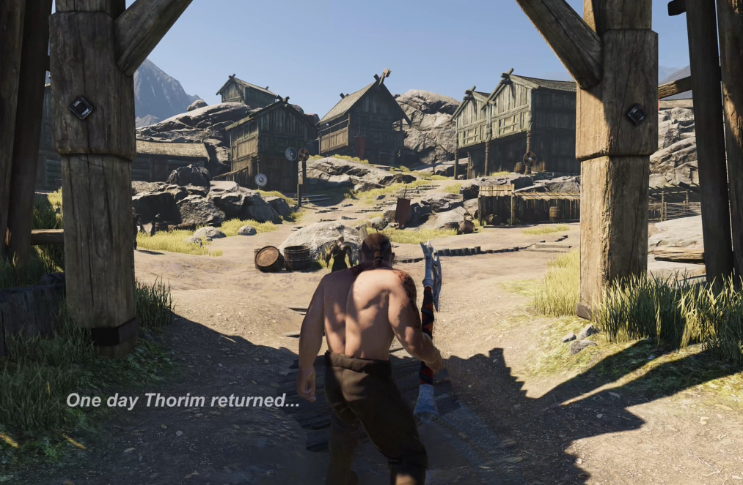
Class overview
Lighting Tutorial package review
Setting up a character’s materials
Default Playables
Creating a Fade in / Fade out effect
NavMeshAgent setup on Timeline
Controlling light
Using Text & Fading
Control Time using Time Dilation
Videoception: Video within your Video
Q&A

Slide 3
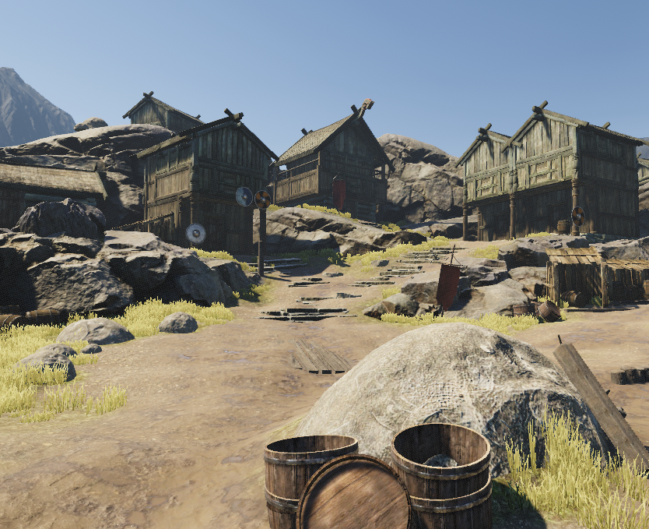
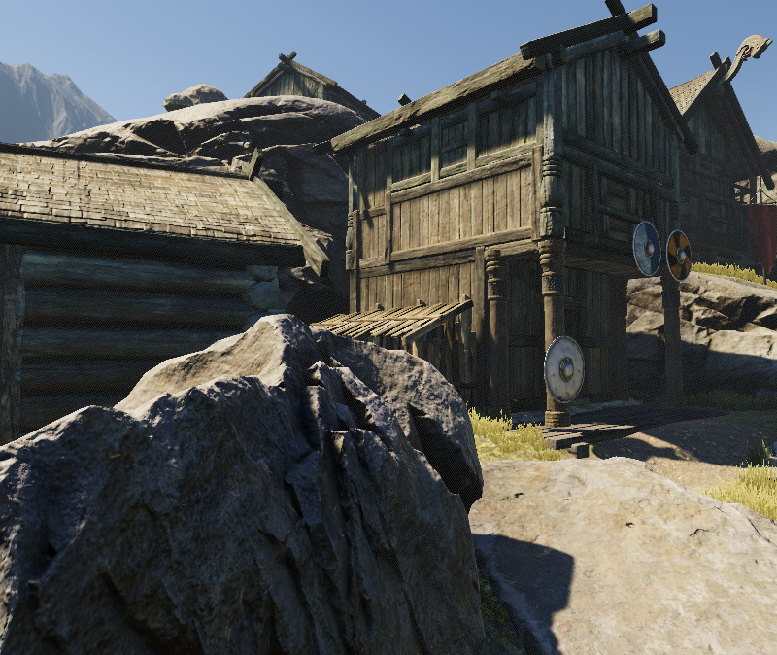
Lighting Tutorial Package review
Good looking Celtic / Viking environment
Optimized scene for good performance
Default Rendering Pipeline (No HDRP)

Slide 4
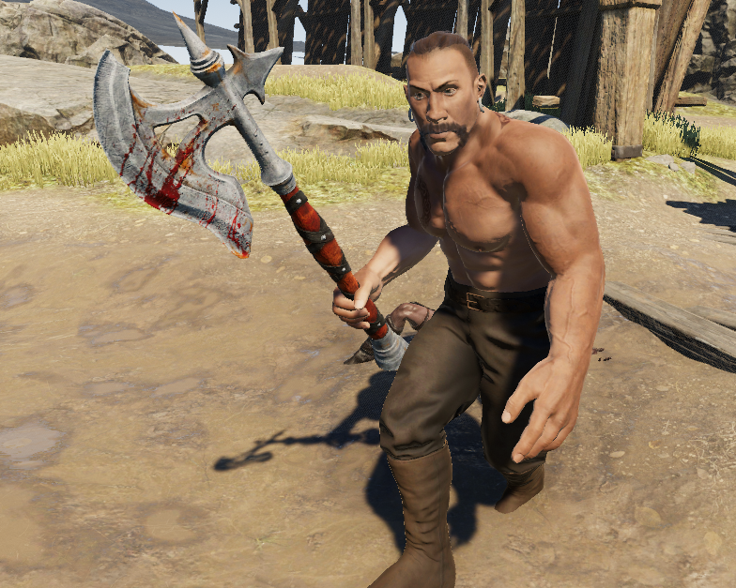
Setting up a Character’s materials
Go to Mixamo.com
Download the Brute
Import into Unity
Select Brute’s Materials
Reduce Plastic feeling on body
Fix non-transparent issues on hair

Slide 5
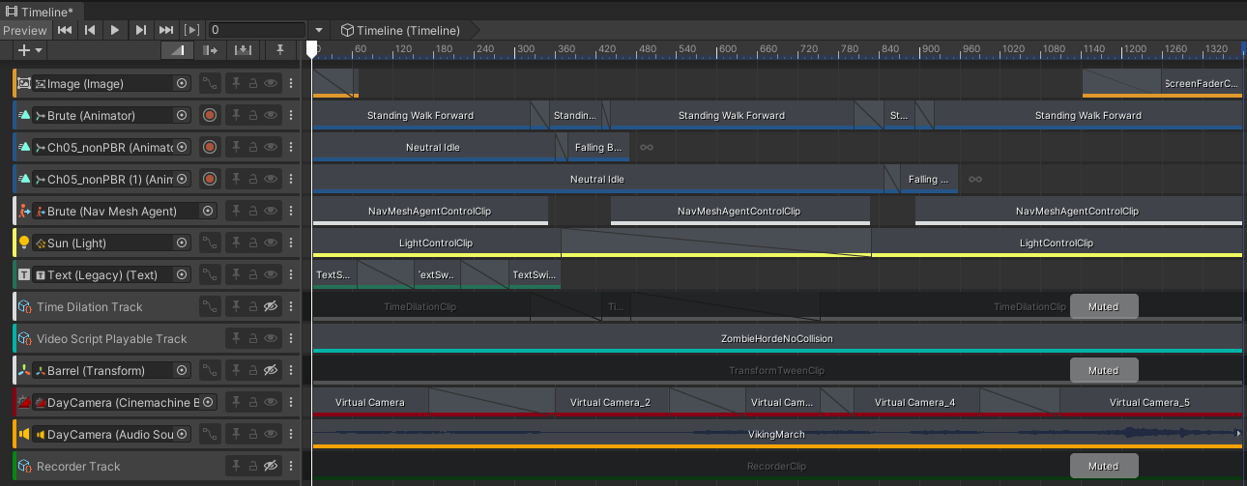
Default Playables
Default Playables allow for extended Timeline functionalities
Reduce the need for coding for specific effects

Slide 6
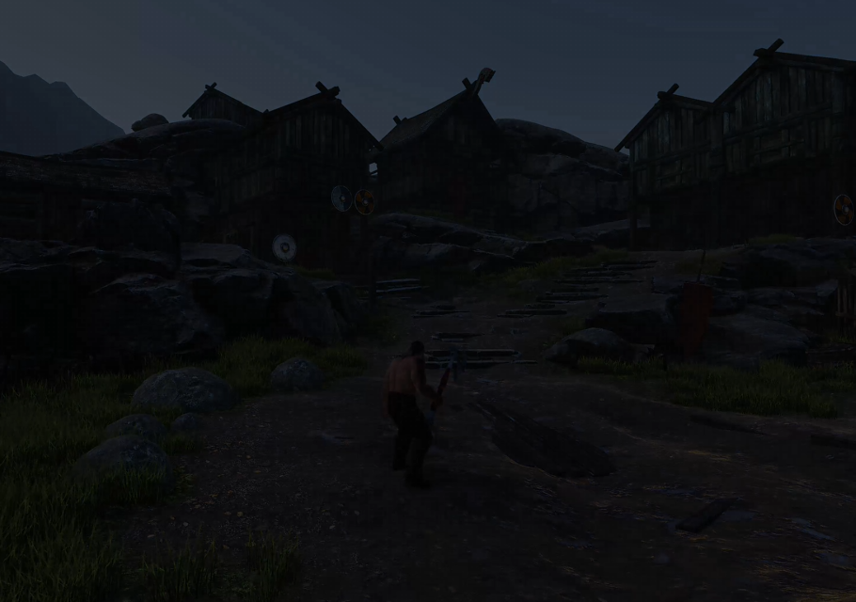
Creating a Fade in / Fade out effect
Add a Screen Fader Track to your Timeline
Create a UI Image
To achieve a Fade in / Fade out effect:
Set up 2 Screen Fader Clips
Set up transparency values
Select color (black)
Set up transition

Slide 7
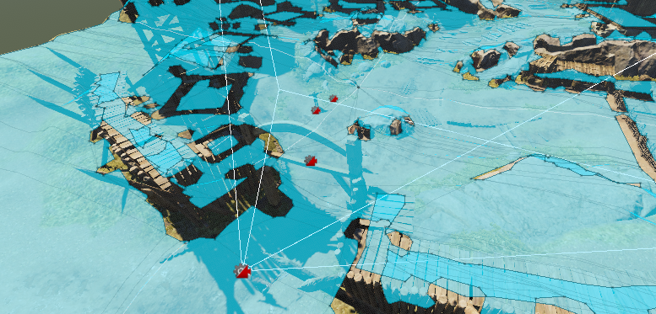
NavMeshAgent setup on Timeline
Create a NavMesh Agent Control Track
Select a character to use Navigation
Import AI Navigation Package
Create an object and add NavMeshSurface
Create objects as Destination Waypoints
Create NavMeshAgentControlClips

Slide 8
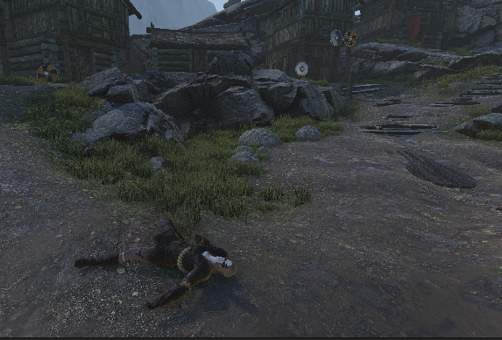
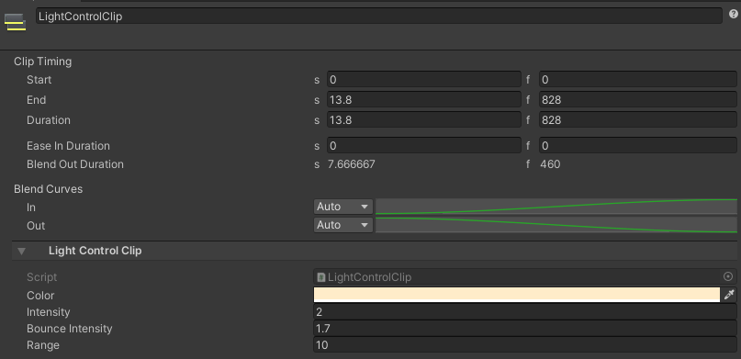
Controlling light
Create a Light Control Track
Set up 2 Light Control Clips
Transition between both Clips

Slide 9
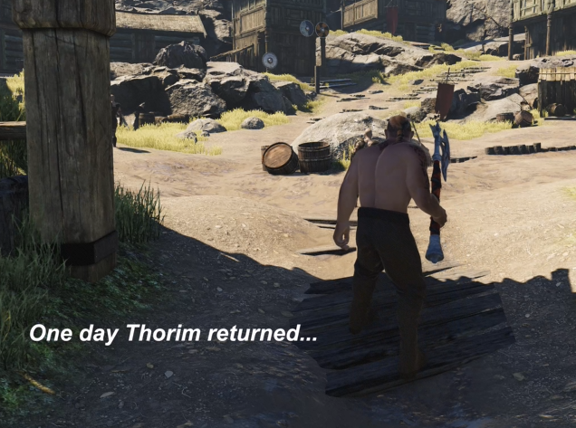
Using Text & Fading
Create a Text Switcher Track
Create a UI Text (regular not Text Mesh Pro)
Create 3 Text Switcher Clips
Fade in Text and Fade out Text

Slide 10
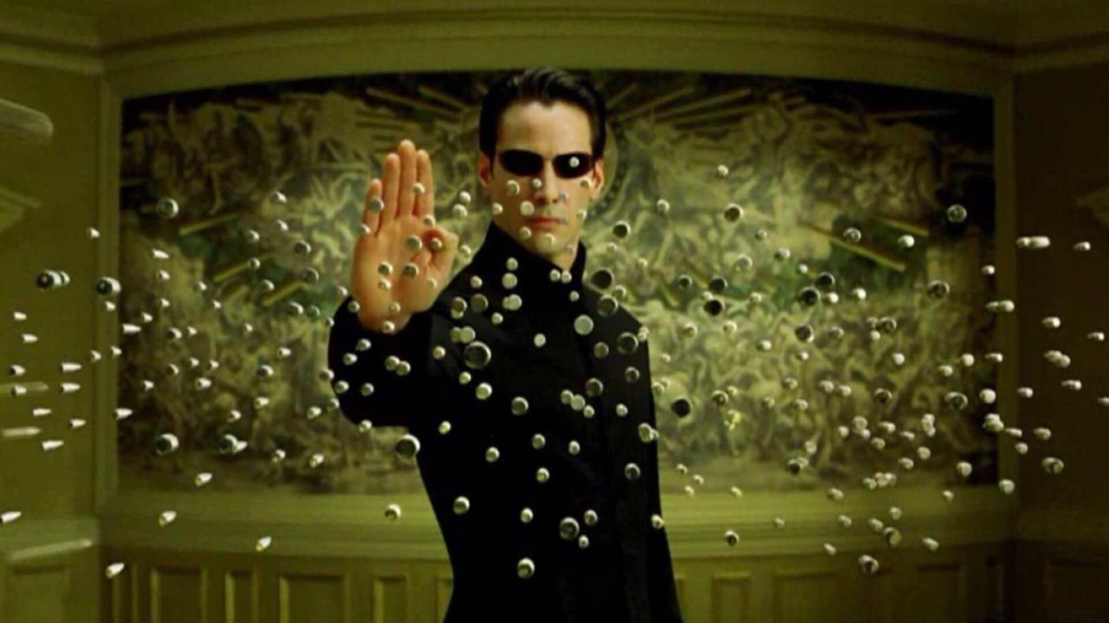
Control Time using Time Dilation
Create a Time Dilation Track
Create 3 Time Dilation Clips
Transition Time speed from normal to slow motion
Transition Time speed from slow motion back to normal

Slide 11
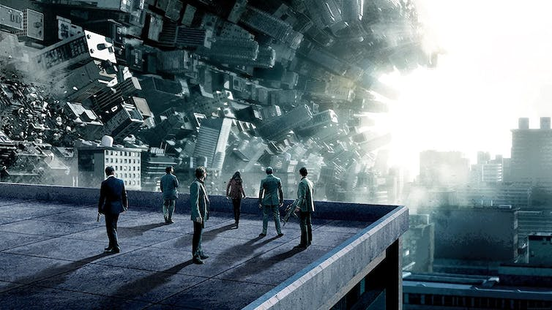
Videoception: Video within your Video
Create a Video Script Playable Track
Create a 3D Plane
Add a Video Player Component
Create a Video Script Playable Asset
Select the video you would like to play

Slide 12
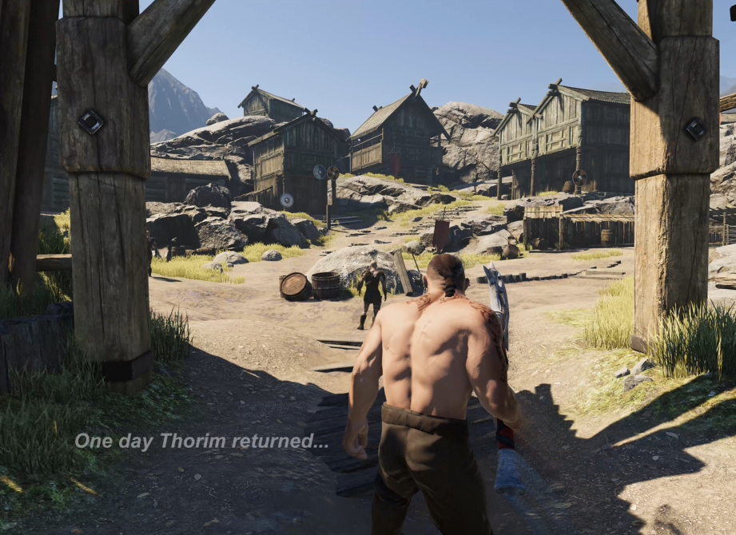
Q&A
Do you have any questions related to the topics mentioned?

