Slide 1
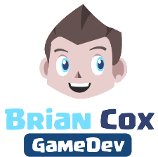
Cinematic Studies
Source Control & Simulation

Slide 2
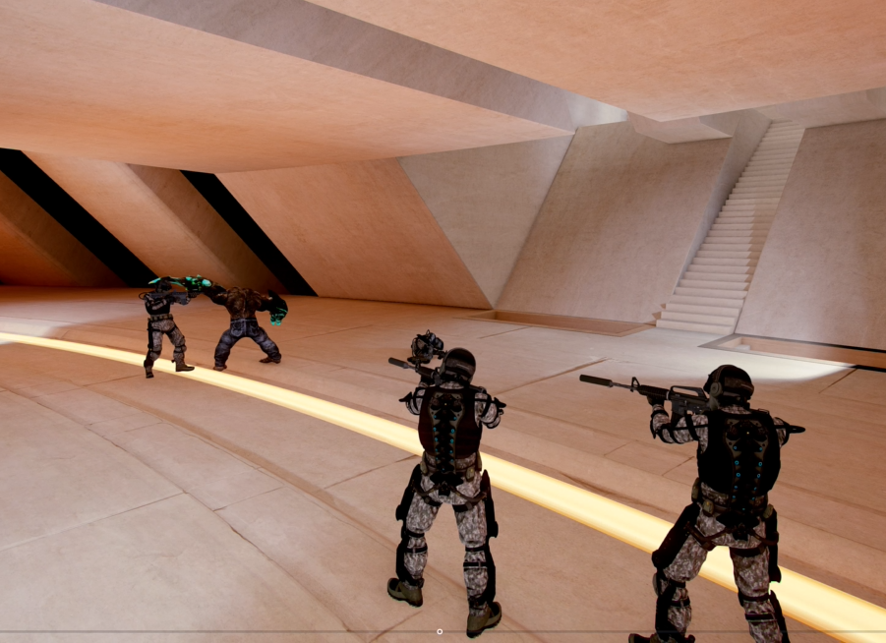
Class overview
Project Planning
Source Control
SourceTree & BitBucket
Create a Repository
Setting up Unity for Source Control
Creating a .gitignore file
Commit, Push & Pull
Simulation

Slide 3
Project Planning
Brainstorm
Gain inspiration
Evaluate ideas
Create a planning
Create a Project scope
Avoid feature creep
Cut features
Focus on shipping
Go for quality, not quantity

Slide 4
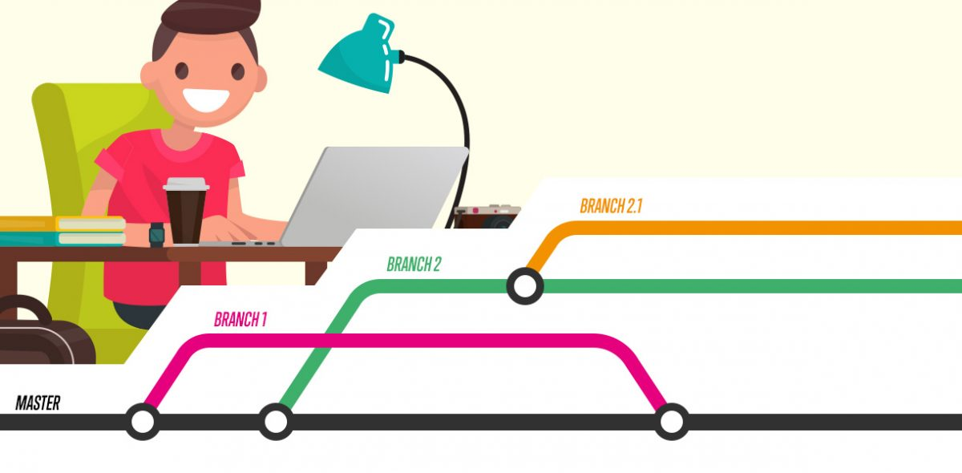
Source Control
Source control (or version control) is the practice of tracking and managing changes to code and data.
Source controlmanagement (SCM) systems provide a running history of code development and help to resolve conflicts when merging contributions from multiple sources.

Slide 5
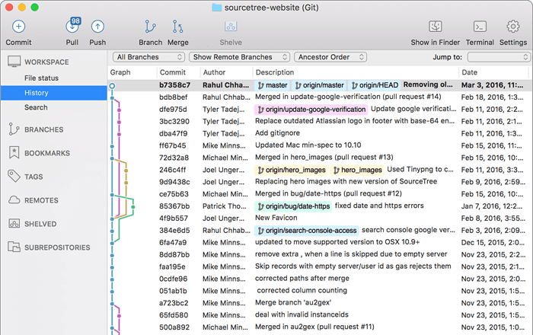
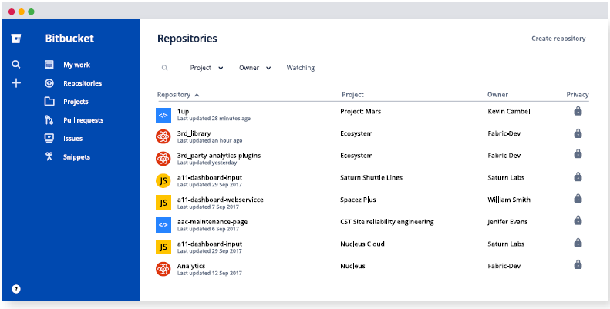
&
Sourcetree = a Git GUI that offers a visual representation of your repositories.
Bitbucket = a web-based version control repository hosting service owned by Atlassian, for source code and development projects that use either Mercurial or Git revision control systems.

Slide 6
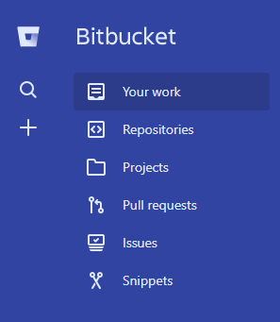
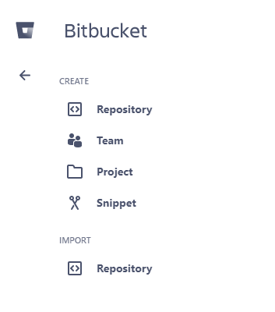
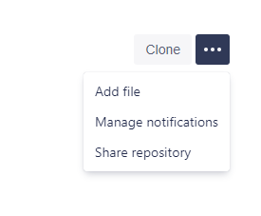
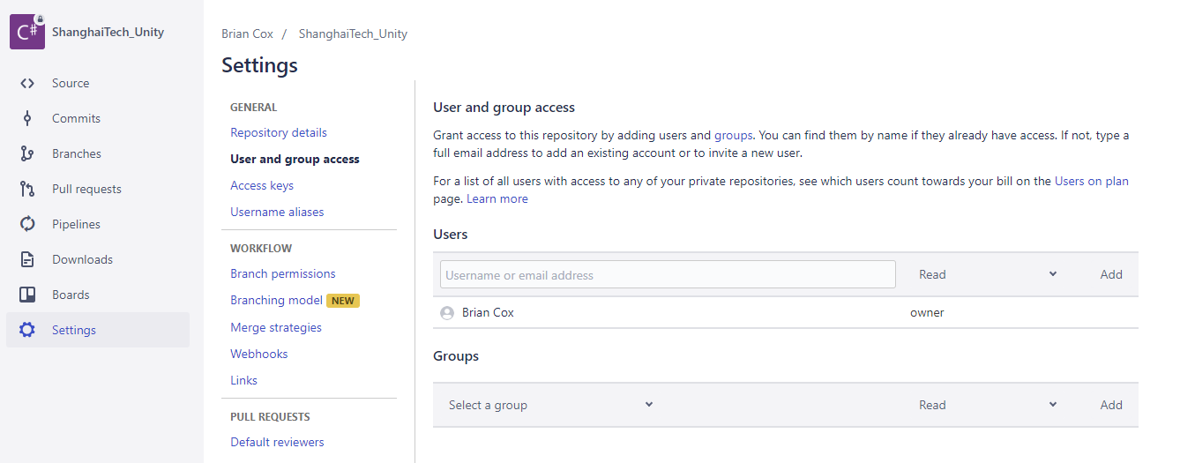
Create a Repository
Create a repository on BitBucket
Add users & give access
Clone repo to local directory

Slide 7
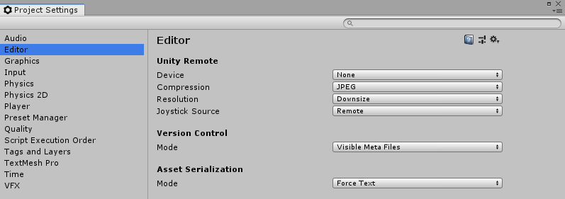
Setting up Unity for Source Control
Version Control → Visible Meta Files
Asset Serialization → Force Text

Slide 8
Creating a .gitignore file
A .gitignore file will allow you to ignore certain folders
Create a text file, call it: .gitignore.
Windows will automatically make it a typeless file if the file name ends with a .
Edit the file using any text editor
Folders that should be ignored are the Library, obj and Temp folders
ProjectFolderName/Library/
ProjectFolderName/obj/
ProjectFolderName/Temp/

Slide 9
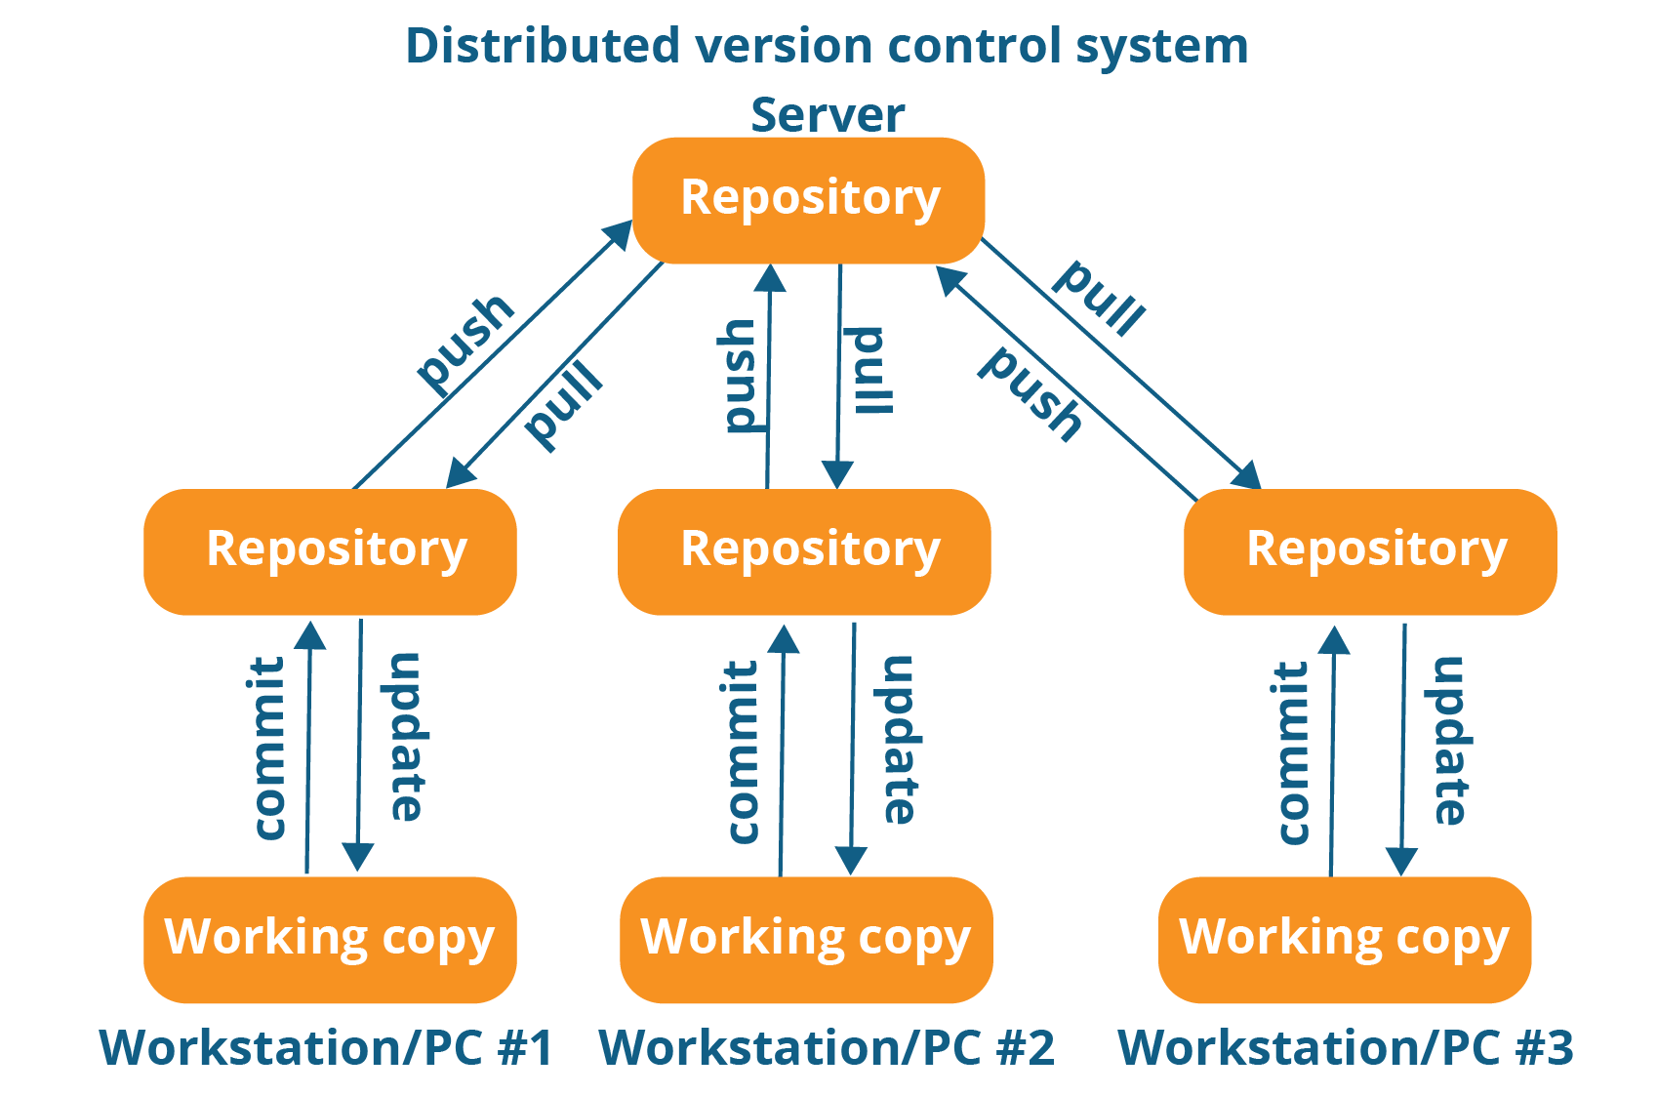
Commit, Push & Pull
Commit = adds the latest changes of code and/or data to local repository.
Push = pushes the commit from local repository to remote repository.
Pull = get latest version from remote repository to local repository

Slide 10
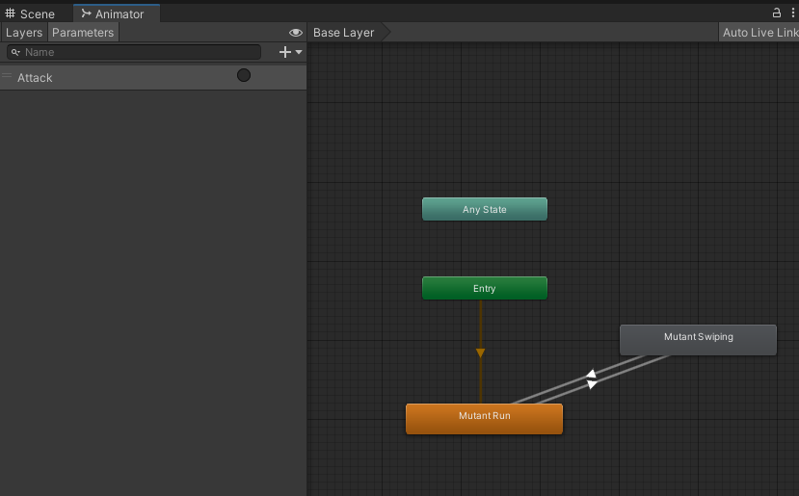
Simulation
To create a Cinematic Simulation you can use the following setup
AnimatorController
NavMeshAgent
C# script for Logics & Animation Behaviour
AnimationEvents

Slide 11
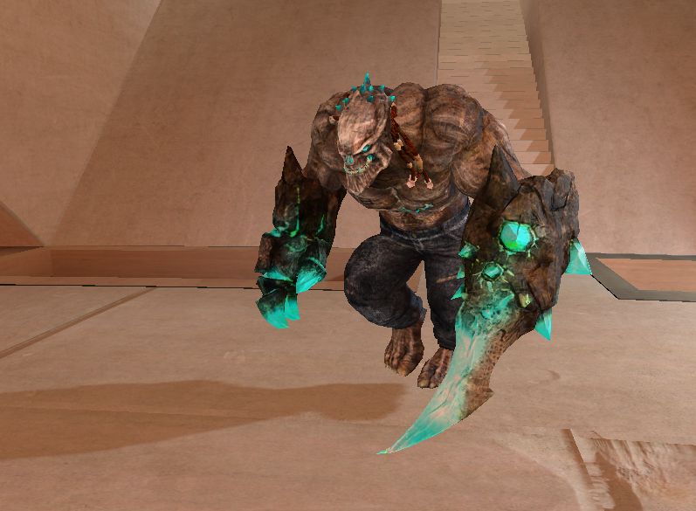
Q&A
Do you have any questions related to the topics mentioned?

