Slide 1
Cinematic Studies
Creating a digital Camera sequence

Slide 2
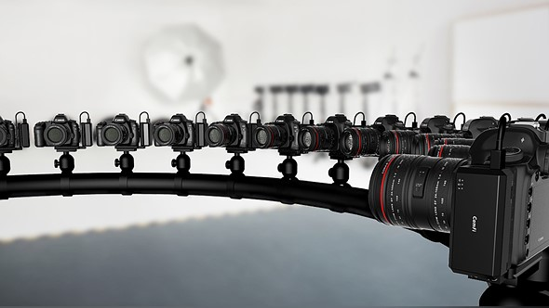
Class overview
Setting up characters for static posing
Getting animations from Mixamo!
Precise asset placement using Bones
Cinemachine & Virtual Cameras
Cinemachine Brain
Moving & Aiming Cameras
Body Property
Aim Property
Composing a Shot
Camera Tracking
Setting up Virtual Cameras
Timeline
(Unity) Recorder
Q&A

Slide 3
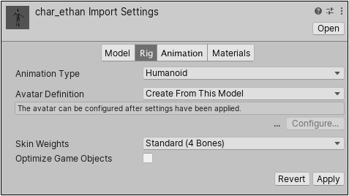
Setting up characters for static posing
Find Character Prefab and 3D model
Setup Character model to reveal bones (change setting in rig)
Off

Slide 4
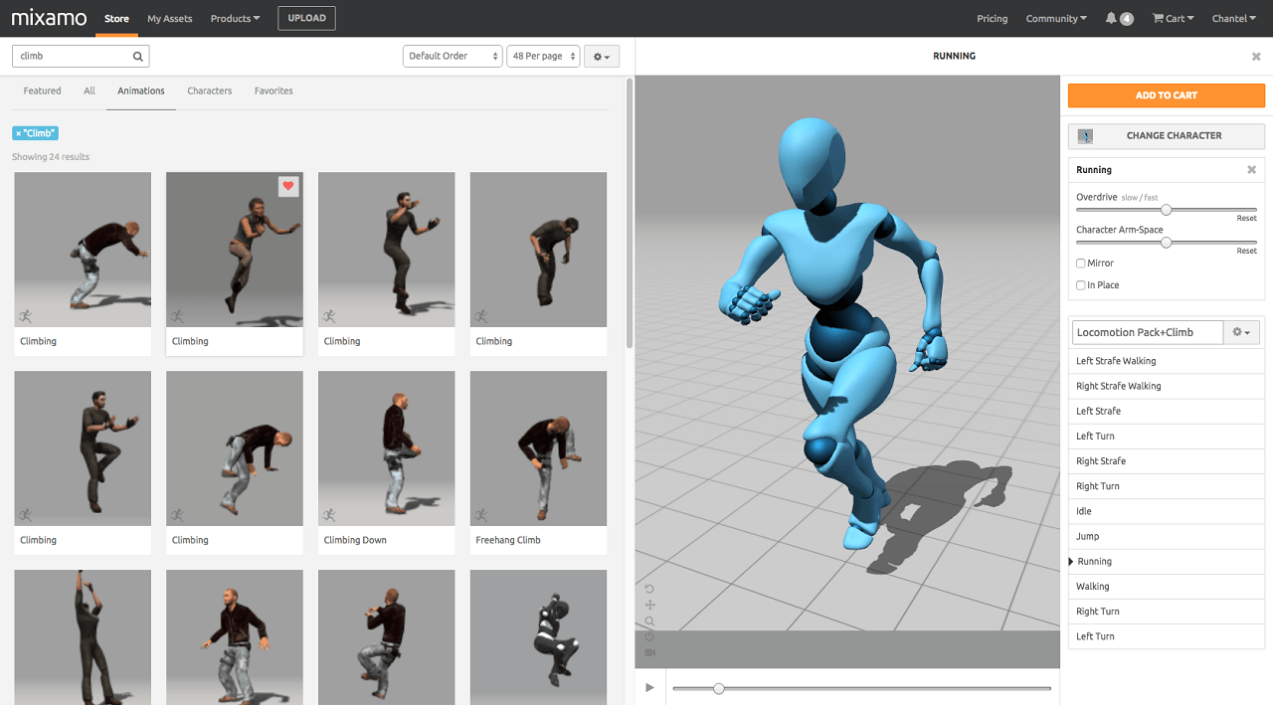
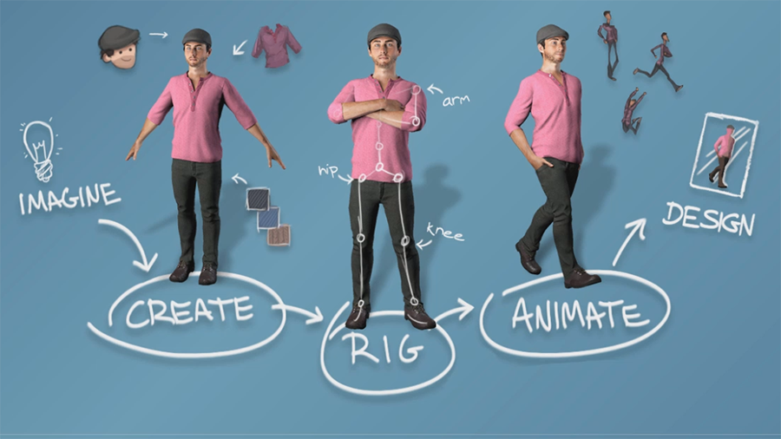
Getting animations from Mixamo!
Go to www.mixamo.com
Create an Adobe Account
Upload your character or download an existing one
Choose an animation
Download and import animation

Slide 5
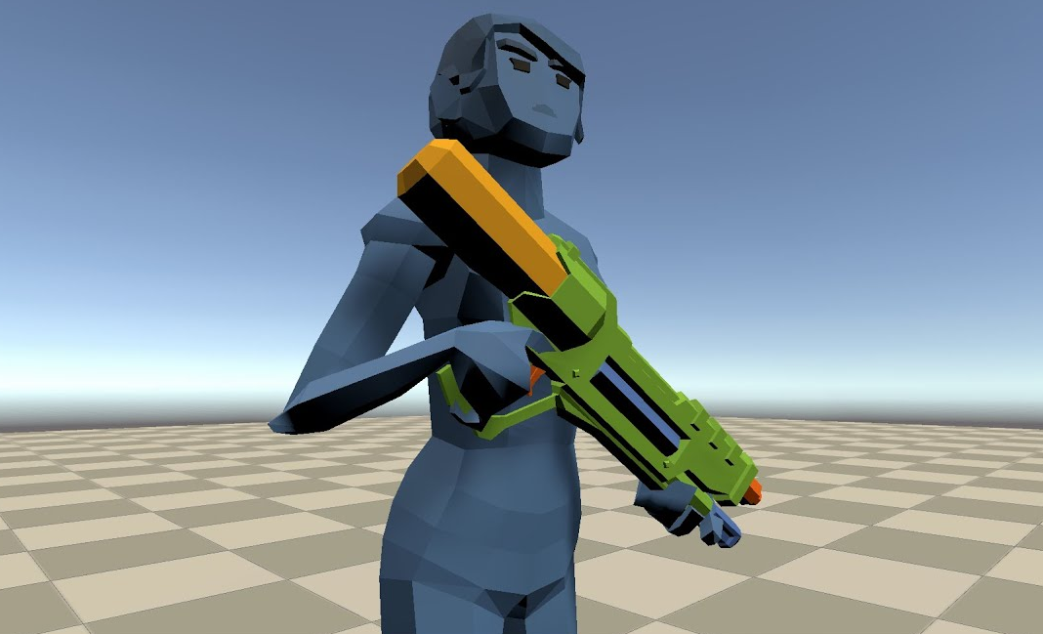
Precise asset placement using Bones
Find an asset like a weapon you would like the character to hold
Find the left hand or right hand bone
Place the Asset in the hand of the character
Tweak and improve the positioning
Check the character pose

Slide 6
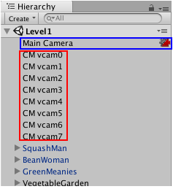
Cinemachine & Virtual Cameras
Cinemachine does not create new cameras.
It directs a single Unity camera for multiple shots.
You compose these shots with Virtual Cameras.
Virtual Cameras move and rotate the Unity camera and control its settings.
The main tasks that the Virtual Camera does for you:
Position the Unity camera in the Scene.
Aim the Unity camera at something.

Slide 7
Cinemachine Brain
The Cinemachine Brain is a component in the Unity Camera itself.
Cinemachine Brain monitors all active Virtual Cameras in the Scene.
To specify the next live Virtual Camera, you activate or deactivate the desired Virtual Camera's game object.
Cinemachine Brain then chooses the most recently activated Virtual Camera with the same or higher priority as the live Virtual Camera.
It performs a cut or blend between the previous and new Virtual Cameras.
Use Timeline to choreograph cameras in predictable situations, like cutscenes.
Timeline overrides the Cinemachine Brain priority system to give you precise, to-the-frame camera control.

Slide 8
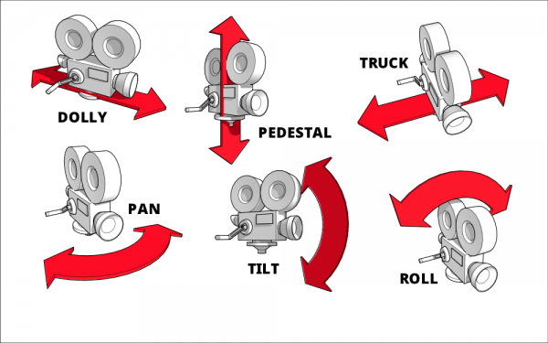
Moving & Aiming Cameras
Use the Body properties in a Virtual Camera to specify how to move it in the Scene.
Use the Aim properties to specify how to rotate it.
A Virtual Camera has two targets:
The Follow target specifies a GameObject for the Virtual Camera to move with.
The Look At target specifies the GameObject to aim at.
Use the CinemachineComponent class to implement a custom moving or aiming behavior.

Slide 9
Body Property
The Body properties offer the following procedural algorithms for moving the Virtual Camera in a Scene:
Transposer: Move in a fixed relationship to the Follow target, with optional damping.
Do Nothing: Do not move the Virtual Camera.
Framing Transposer: Move in a fixed screen-space relationship to the Follow target, with optional damping.
Orbital Transposer: Move in a variable relationship to the Follow target, optionally accepting player input.
Tracked Dolly: Move along a predefined path.
Hard Lock to Target: Use the same position at the Follow target.

Slide 10
Aim Property
The Aim properties offer the following procedural algorithms for rotating a Virtual Camera to face the Look At target:
Composer: Keep the Look At target in the camera frame, with compositional constraints.
Group Composer: Keep multiple Look At targets in the camera frame.
Do Nothing: Do not rotate the Virtual Camera.
POV: Rotate the Virtual Camera based on the user’s input.
Same As Follow Target: Set the camera’s rotation to the rotation of the Follow target.
Hard Look At: Keep the Look At target in the center of the camera frame.

Slide 11
Composing a Shot
The Framing Transposer, Composer, and Group Composer algorithms define areas in the camera frame for you to compose a shot:
Dead zone: The area of the frame that Cinemachine keeps the target in.
Soft zone: If the target enters this region of the frame, the camera will re-orient to put it back in the dead zone. It will do this slowly or quickly, according to the time specified in the Damping settings.
Screen: The screen position of the centre of the dead zone. 0.5 is the centre of the screen.
Damping: Simulates the lag that a real camera operator introduces while operating a heavy physical camera. Damping specifies quickly or slowly the camera reacts to movement of the tracking target.
The Game Window Guides gives an interactive, visual indication of these areas. The guides appear as tinted areas in the Game View.

Slide 12
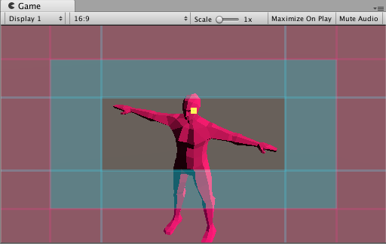
Camera Tracking
The clear area indicates the dead zone.
The blue-tinted area indicates the soft zone. The position of the soft and dead zones indicates the screen position.
The red-tinted area indicates the no pass area, which the target never enters.
The yellow square indicates the target.
Adjust these areas to get a wide range of camera behaviors.
Use this feature for things like animation cycles, where you don’t want the camera to track the target if it moves just a little.

Slide 13
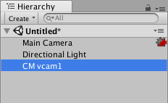
Setting up Virtual Cameras
In your project, organize your Scene Hierarchy to have a single Unity camera with a CinemachineBrain component and many Virtual Cameras.
To add a Virtual Camera to a Scene:
In the Unity menu, choose Cinemachine > Create Virtual Camera.
Use the Follow property to specify a GameObject to follow.
Use the Look At property to specify the GameObject that the Virtual Camera should aim at.

Slide 14
Timeline
You control Virtual Cameras in Timeline with a Cinemachine Shot Clip.
Each shot clip points to a Virtual Camera to activate then deactivate.
Use a sequence of shot clips to specify the order and duration of each shot.
To cut between two Virtual Cameras, place the clips next to each other.
To blend between two Virtual Cameras, overlap the clips.

Slide 15
(Unity) Recorder
Add the Recorder package using Package Manager
Add a Recording Track to the Timeline
Set up the Recording Settings
Press Play in the Scene
Tip: You can use GameObject > Align Object with View to make Cameras align with the Scene View :)

Slide 16
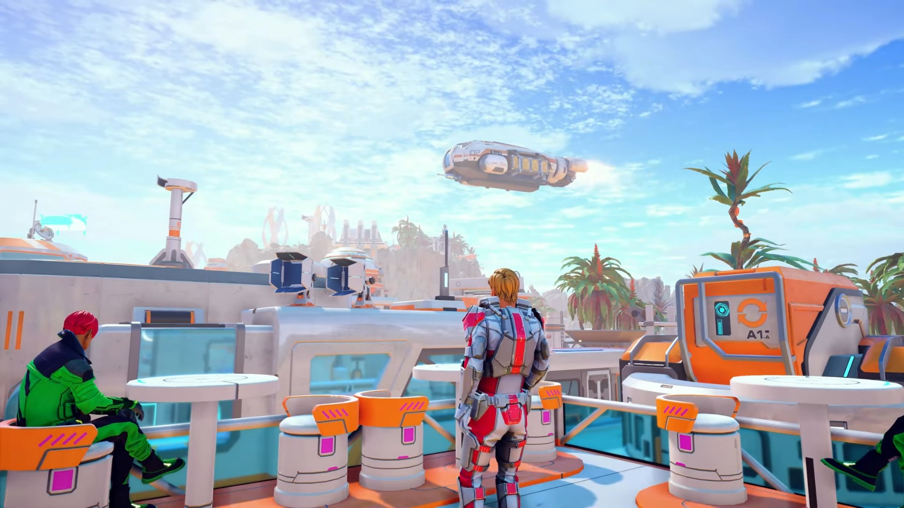
Q&A
Do you have any questions related to the topics mentioned?

