Slide 1
Cinematic Studies
Setting the tone and atmosphere of the movie

Slide 2
Class overview
Work in Progress Review & Feedback
Cinemachine & Timeline
Spatial Audio
Timeline Controlled Audio Effects
Setting Atmosphere using Skybox
Global Lighting
Adding Visual Effects & Particles to a Scene
Controlling the tone and mood using Post-Processing
Q&A

Slide 3
Work in Progress Review & Feedback
1. Show your work in progress
2. Receive feedback
3. Make adjustments before next week’s deadline
4. Get a good grade! :)

Slide 4
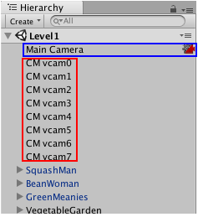
Cinemachine & Timeline
You compose shots with Virtual Cameras.
Virtual Cameras move and rotate the Unity camera and control its settings.
To cut between two Virtual Cameras, place the clips next to each other.
To blend between two Virtual Cameras, overlap the clips.

Slide 5
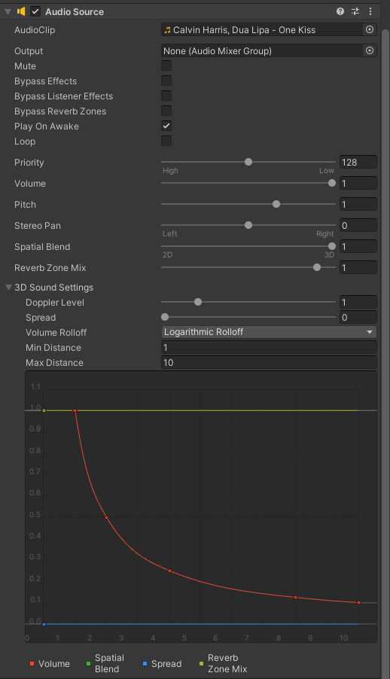
Spatial Audio
Set Spatial Blend to 1
Set Max Distance to 10
Create a Virtual Camera Sequence in Timeline
Think of potential sound effects for your movie

Slide 6
Timeline controlled audio effects
Play Audio Effects at specific moments using Timeline
Use existing Audio Sources (won’t stop current audio) or add new ones

Slide 7
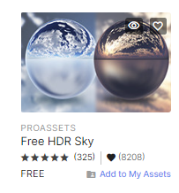
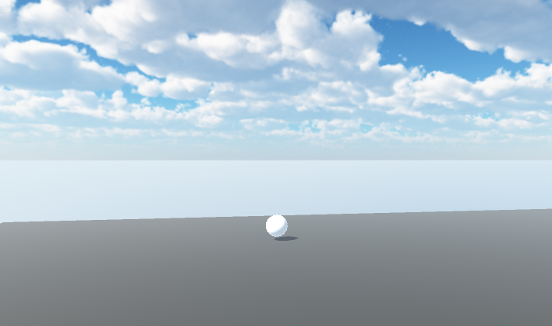
Setting atmosphere using skybox
Go to the Unity Asset Store and get “Free HDR Sky”
Import it to your project
Window > Rendering > Lighting
Set the Skybox Material

Slide 8
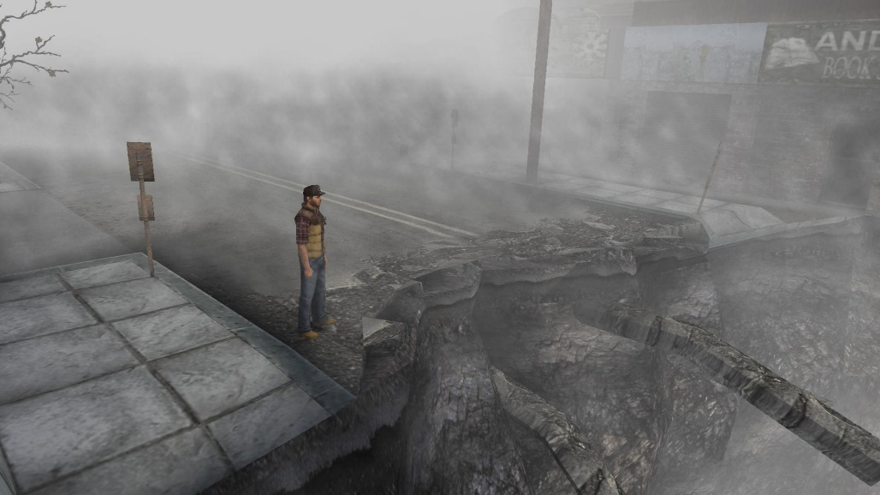
Global Lighting
Experiment with adding Fog to your scene
Reduce and increase overall Lighting intensity

Slide 9
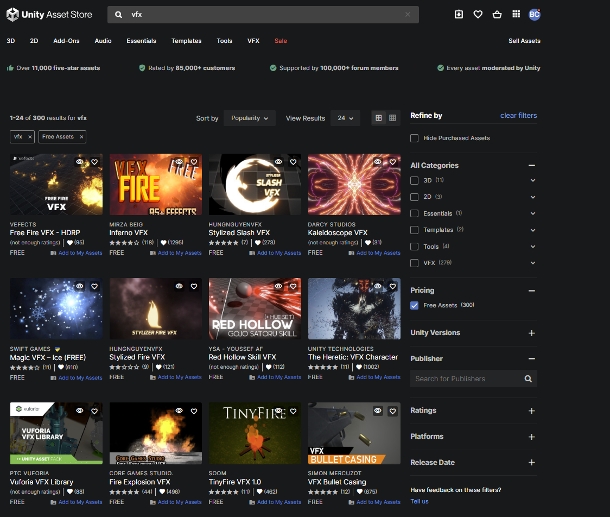
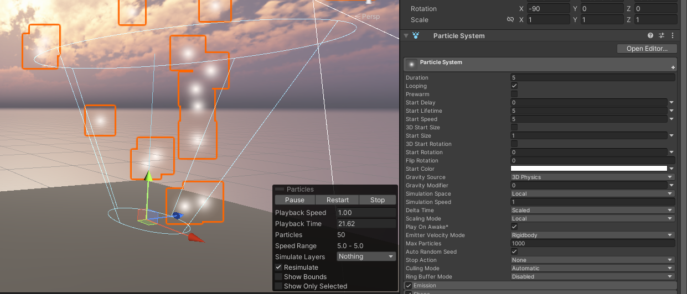
Adding Visual Effects & Particles to a Scene
GameObject > Effects > Particle System
Get Particle Systems from Unity Asset Store
At your own risk: https://unityassets4free.com/

Slide 10
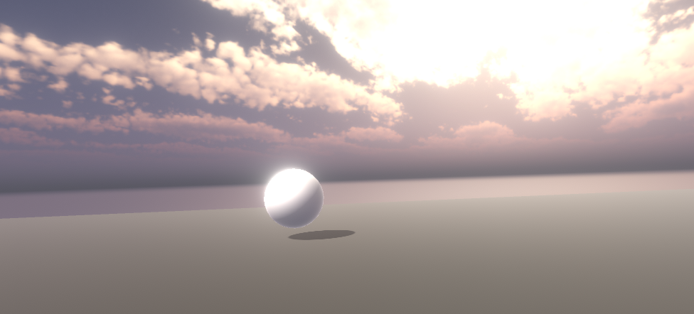
Controlling the tone and mood using Post-Processing
Using the Package Manager add Post-Processing (v2) to your project
Add a Post-Processing Layer to your Main Camera
Create a Post-Processing Volume in your scene or apply it globally
Add Cinemachine Post-Processing Extension to your Virtual Cameras
Time to experiment… but don’t overuse Post-Processing… :)

Slide 11
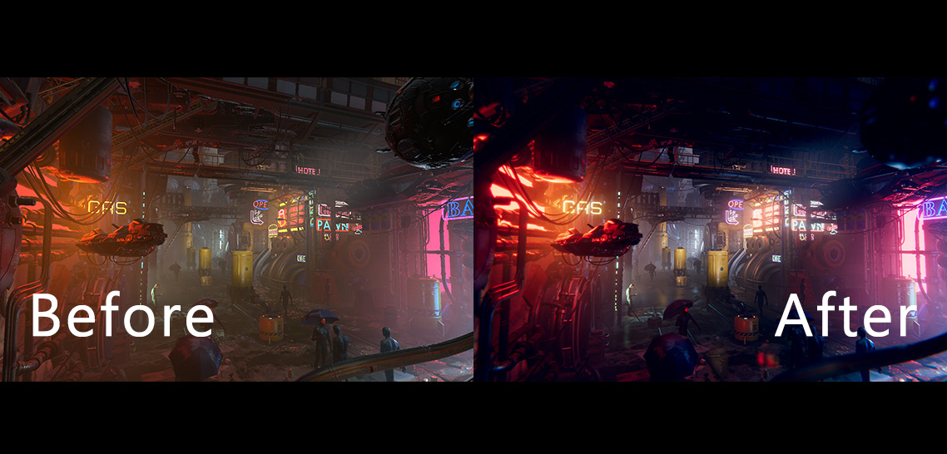
Q&A
Do you have any questions related to the topics mentioned?

