Slide 1
Cinematic Studies
Advanced Animations

Slide 2
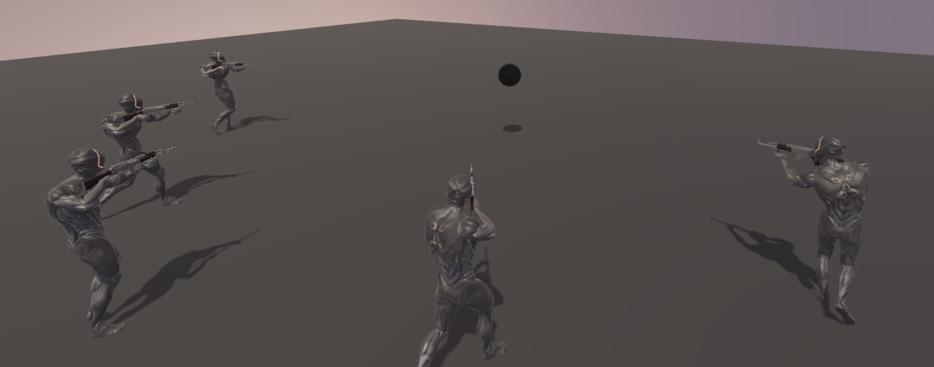
Class overview
Triggering Events at specific Animation moments
Animation timing practice
Playing animations on different body parts
Making a character look at their target
Manually rotating a character’s bones
Aiming a Weapon towards a target
Holding a Weapon with both hands
Q&A

Slide 3
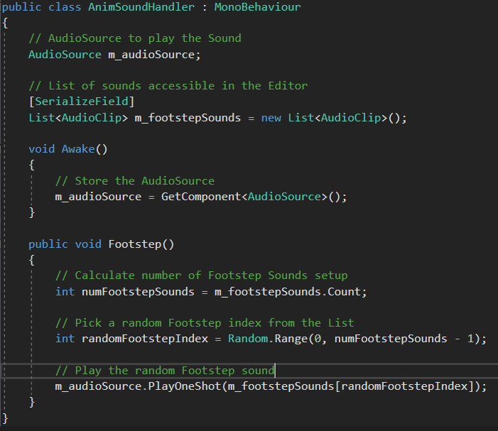
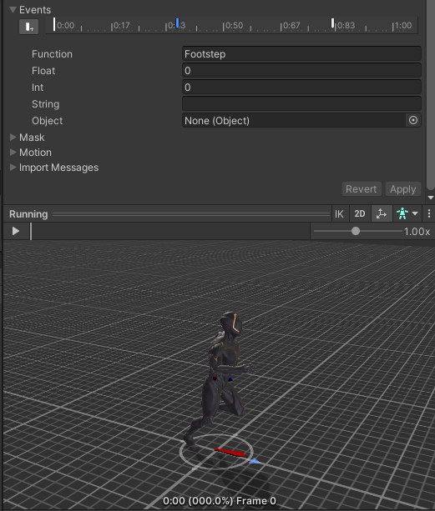
Triggering Events at specific Animation moments
Match every animation with a corresponding sound in the Timeline
Footstep sound manual setup for every step?!?
Use animation events to trigger code functions

Slide 4
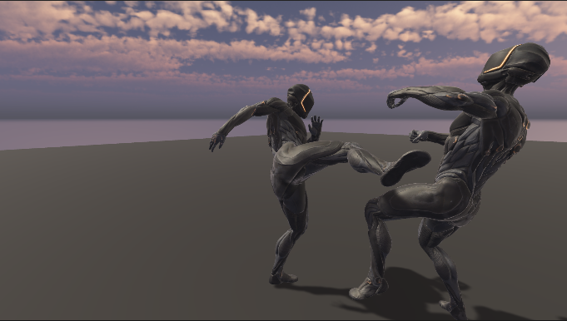
Animation timing practice
Practice:
Precise Animation Setup
Animation Blending
Playing Sound clips at exact moments

Slide 5
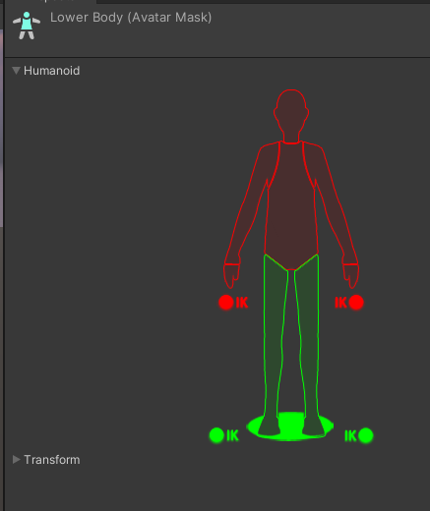
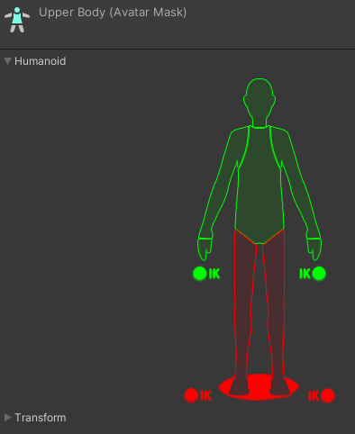
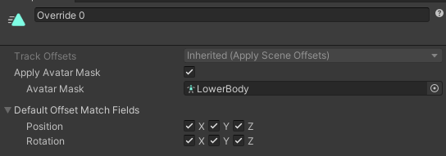
Playing animations on different body parts
To play animations on part of a character’s body you need to setup an Avatar Mask
An Avatar Mask let’s you define which bones you want to activate / deactivate
Using an override track in the Timeline you can play multiple animation tracks
Be sure to setup the Avatar Mask in order to not override every character’s bone

Slide 6
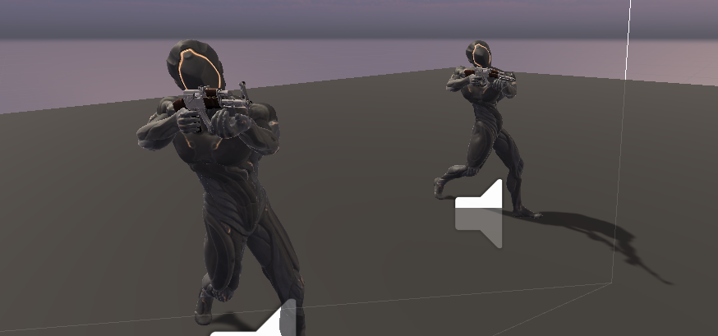
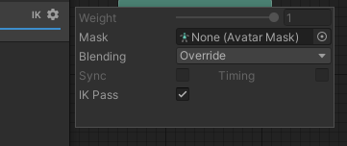
Making a character look at their target
Using Inverse Kinematics (IK) you can make a character look at their target
By setting the LookAt Position and Weight the character will look at the target
This setup has to be done in the OnAnimatorIK function
An AnimatorController needs to be active with IK enabled

Slide 7
Manually rotating a character’s bones
Try to rotate a character’s animation in the Timeline
Notice that only the lower part (root) can be rotated
It is impossible to rotate a character’s bones in the Timeline
Using code however it is possible to manually rotate a character’s bones

Slide 8
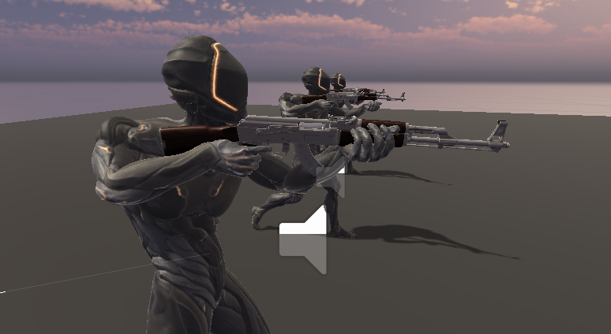
Aiming a Weapon towards a target
Attach a weapon to the character’s right hand bone
Setup the Position and Rotation during Play Mode
Pause the game, tweak the positioning then copy the transform component
Exit Play Mode and paste the Component Values to the weapon

Slide 9
Holding a Weapon with both hands
In order to hold a weapon with both hands you need to use IK
Since a weapon can only be attached to 1 bone you have to use IK for other bones
Using IK you can define the position and rotation of a bone
You can also setup the IK weight, most of the time it will be either 0 or 1

Slide 10
Q&A
Do you have any questions related to the topics mentioned?

