Slide 1
Cinematic Studies
Realistic & High Definition Visuals

Slide 2
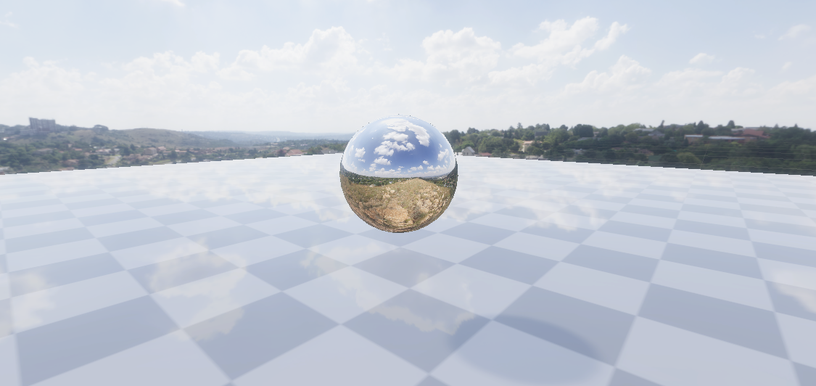
Class overview
Comparison: Default Rendering vs. HDRP
“Adam” Unity Showcase Video
Assignment Preview discussion
High Definition Rendering Pipeline (HDRP)
Upgrading an existing scene to HDRP
Editing sound with Audacity
Creating a Dolly Camera
Using Signal Emitters
Q&A

Slide 3
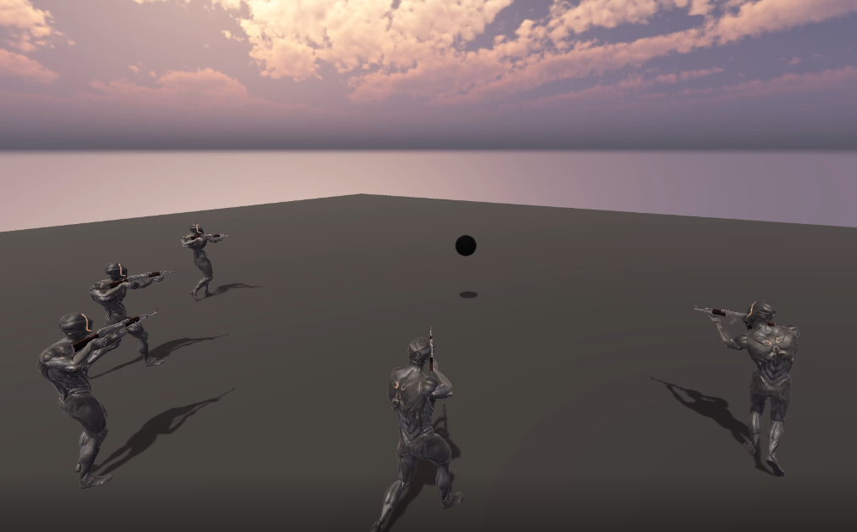
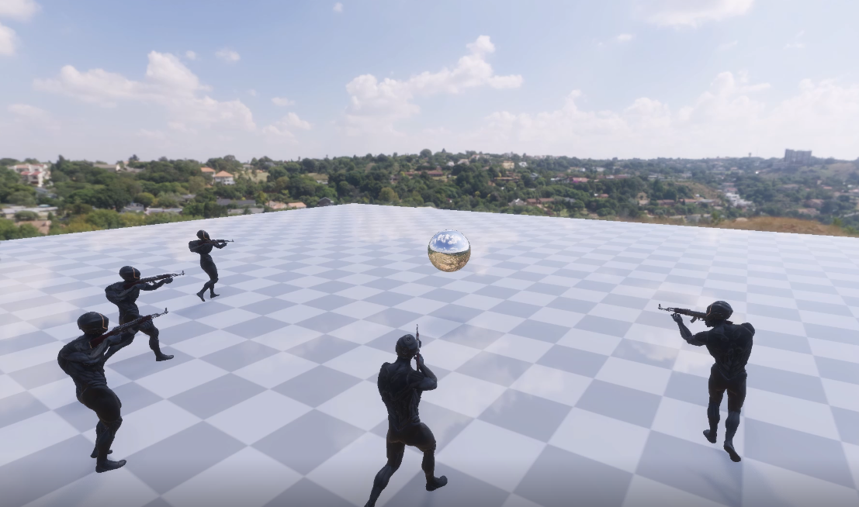
Comparison: Default Rendering vs. HDRP
Compare both videos
Choose which rendering style is preferential for your project
Default Rendering Pipeline High Definition Rendering Pipeline

Slide 4
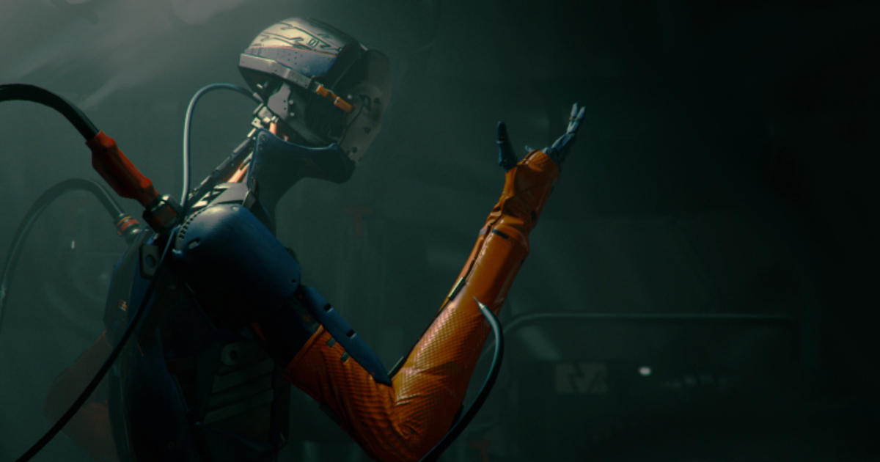
“Adam” Unity Showcase Video

Slide 5
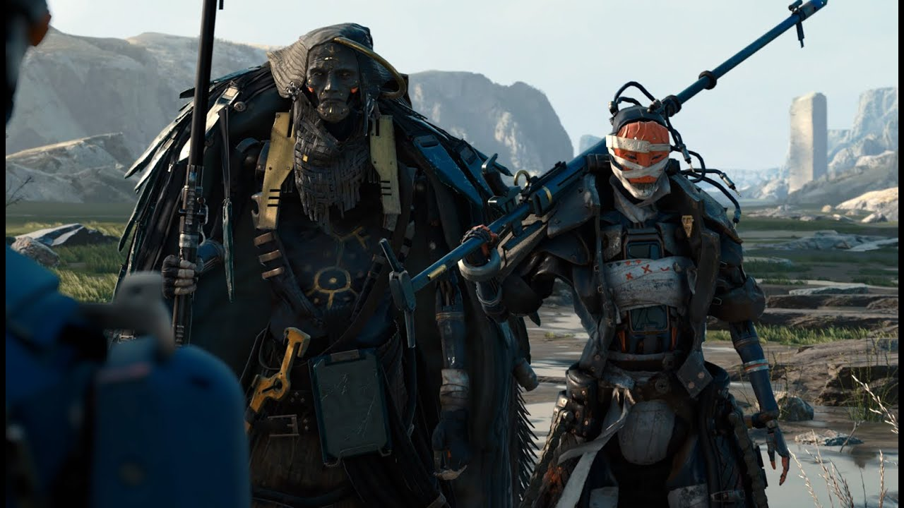
Assignment Preview discussion
Show your work in progress (if you have it)
Tell us about your movie plan
What is the story behind your movie?

Slide 6
High Definition Rendering Pipeline (HDRP)
The High Definition Render Pipeline (HDRP) is a high-fidelity Scriptable Render Pipeline built by Unity to target modern (Compute Shader compatible) platforms.
HDRP utilizes physically based Lighting techniques, linear lighting, HDR lighting, and a configurable hybrid Tile/Cluster deferred/Forward lighting architecture.
It gives you the tools you need to create applications such as games, technical demos, and animations to a high graphical standard.
Note: A project can either be default, URP or HDRP.

Slide 7
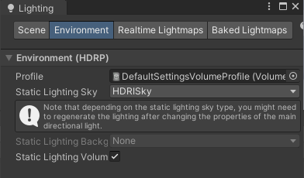
Upgrading an existing scene to HDRP
Backup your project first!!! This process is irreversible!!!
Go to Window > Package Manager and add and install “High Definition RP”
Window > Rendering > HDRP Wizard will help upgrade your project
Some materials will appear as pink and will need additional setup
Set them up as HDRP/Lit shader Materials

Slide 8
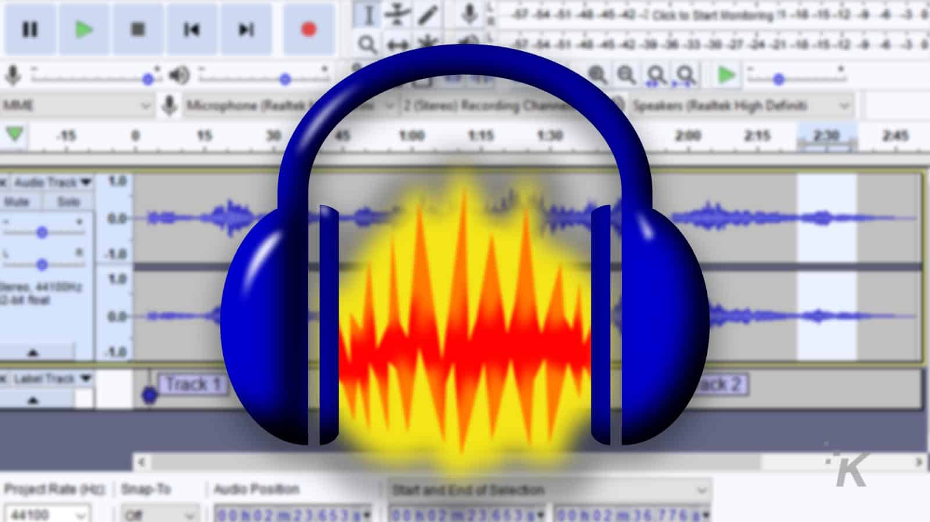
Editing sound with Audacity
Download Audacity
Download a sound clip of several footsteps
Splice them into separate audio files

Slide 9
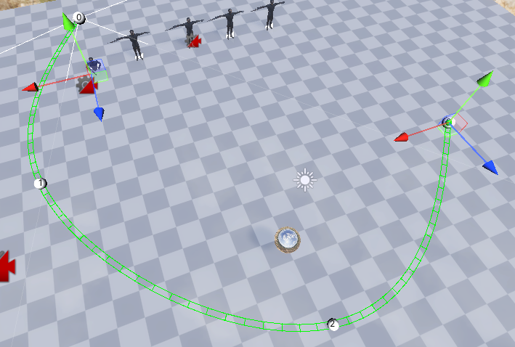
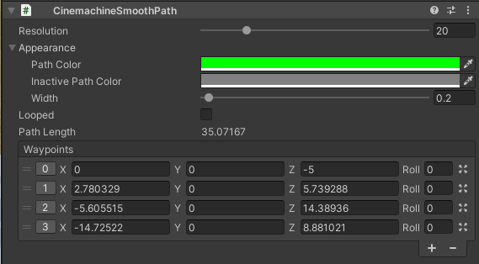
Creating a Dolly Camera
Set up a Dolly Camera
Add new Path Waypoints to the Dolly
Timeline: Add an animated path & record Camera movement along Path

Slide 10
Using Signal Emitters
Add a Signal Emitter to your Timeline
Execute simple logic in any C# script

Slide 11
Q&A
Do you have any questions related to the topics mentioned?

