Slide 1
Cinematic Studies
Using Physics to reduce Animation work

Slide 2
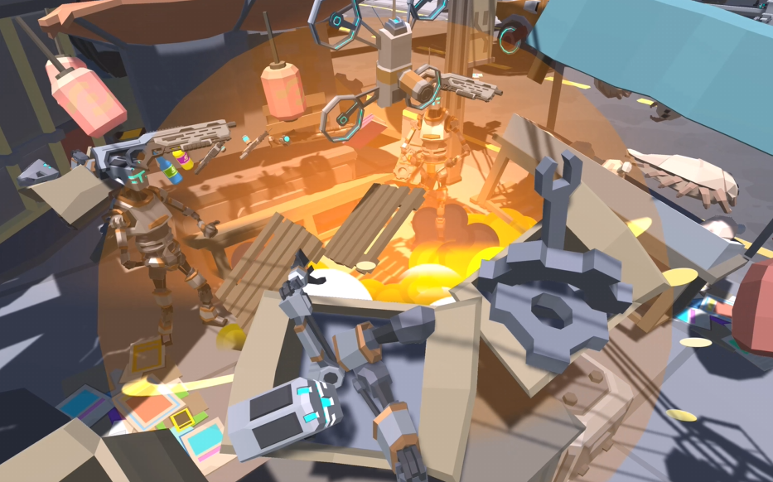
Class overview
Drone Attack video analysis
Assignment Preview discussion
Using Signal Emitters
Colliders & Rigidbody
Creating an explosion using Physics
Q&A

Slide 3
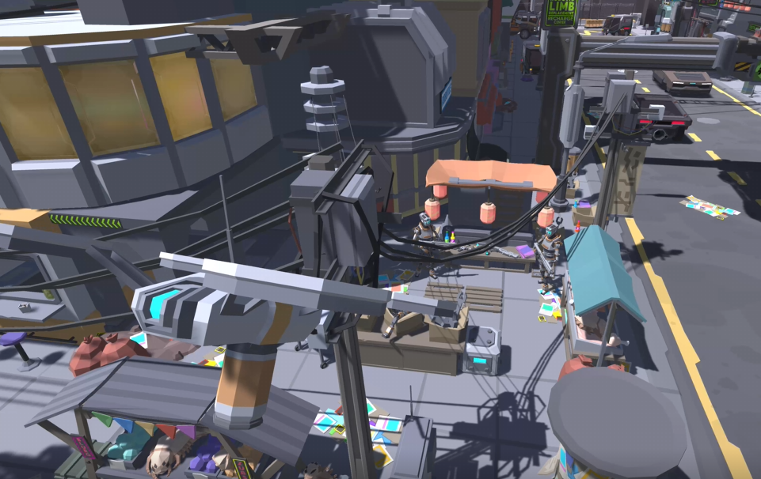
Drone attack video analysis
Discuss the video
How many animations?
How many cameras?
Which camera transitions?
Any movement animations?

Slide 4
Assignment Preview discussion
Show your work in progress
What is the story behind your movie?

Slide 5
Using Signal Emitters
Add a Signal Emitter to your Timeline
Add a Signal Listener to your GameObject
Execute public function logic in C# script

Slide 6
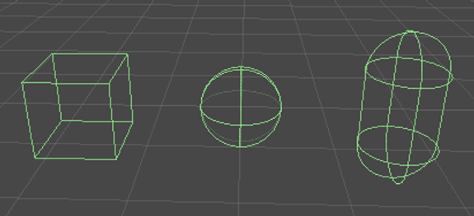
Colliders & Rigidbody
If you want to target objects within a certain range they need to have colliders
You can check a specific PhysicsLayer or check any objects with a collider in range
Adding a Rigidbody component to an object will put its motion under the control of Unity's physics engine.
Even without adding any code, a Rigidbody object will be pulled downward by gravity and will react to collisions with incoming objects if the right Collider component is also present.
The Rigidbody also has a scripting API that lets you apply forces to the object and control it in a physically realistic way.

Slide 7
Creating an explosion using physics
Physics.OverlapSphere to target every Collider within a certain radius (sphere)
Attach Rigidbodies to objects and set the mass as well as isKinematic to true
During explosion disable the isKinematic effect and AddExplosionForce :)

Slide 8
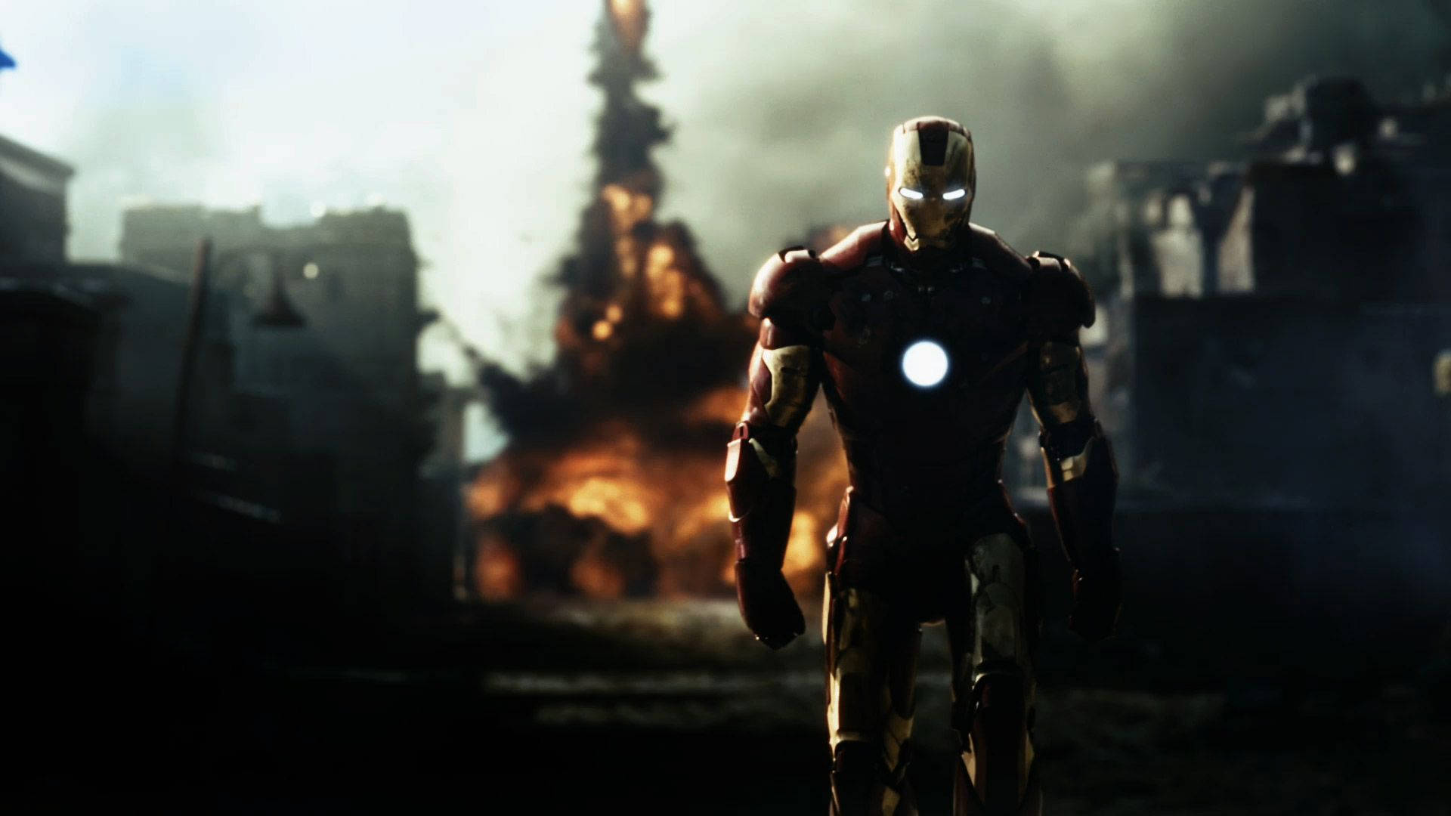
Q&A
Do you have any questions related to the topics mentioned?

