Slide 1
Cinematic Studies
Advanced Special Effects

Slide 2
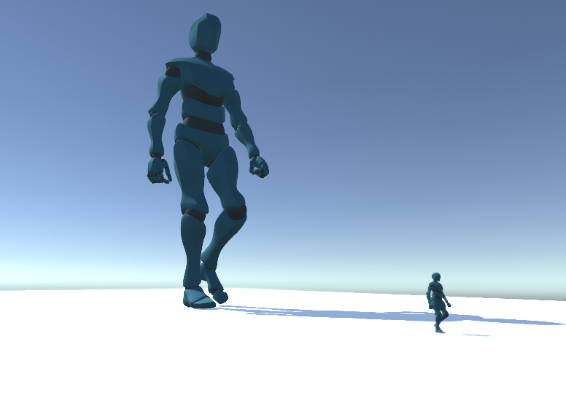
Class overview
Giant video analysis
Assignment discussion
Slowing down time
Camera Shake using Impulse Effects
Depth of Field on Character
Multiple Post-Processing Effects
Updating Post-Processing real-time
Q&A

Slide 3
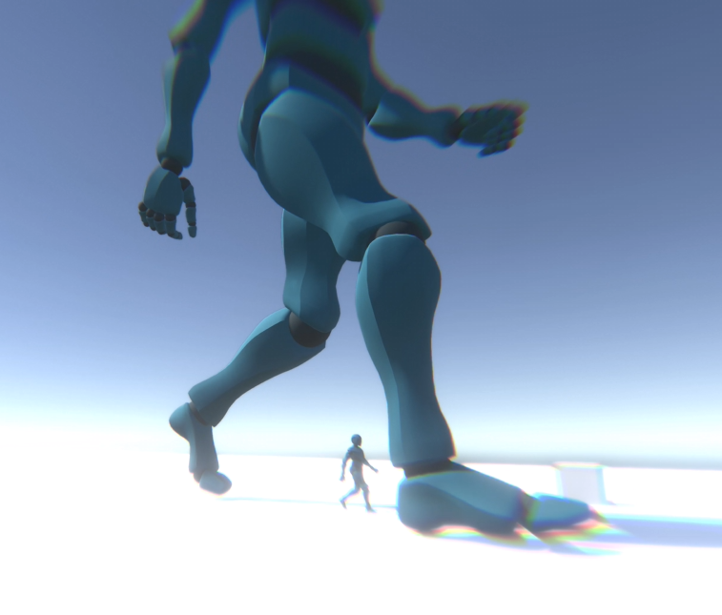
Giant video analysis
Discuss the video
Which effects can you spot?

Slide 4
Assignment discussion
Show your work
Let’s discuss & learn

Slide 5
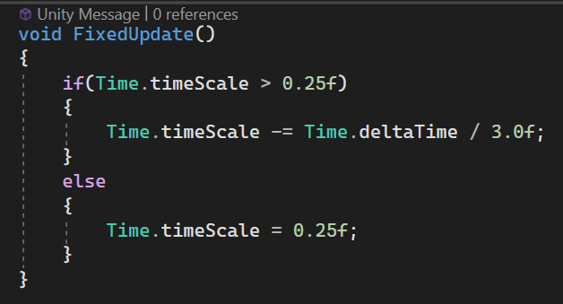
Slowing Down time
Slow down time by adjusting Time.timescale
Use FixedUpdate for constant update values
Set minimum value or reduce until zero

Slide 6
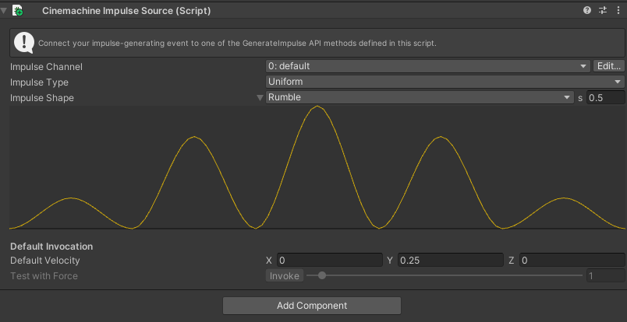
Camera Shake using Impulse Effects
Cinemachine Impulse Source to generate shake
Cinemachine Impulse Listener to receive shake
Trigger Impulse from code logic

Slide 7
Depth of Field on Character
Add Cinemachine Post Processing to Virtual Camera
Create new Post Processing Profile
Add Depth of Field
Tweak values

Slide 8
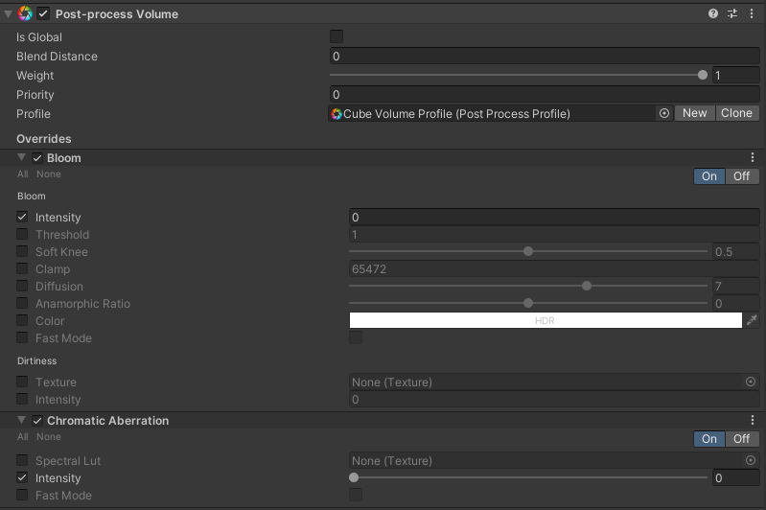
Multiple Post-Processing Effects
Create a Cube
Add Post Processing Volume
Create new Post Processing Profile
Add Bloom
Add Chromatic Aberration
Test to see if Volume is working

Slide 9
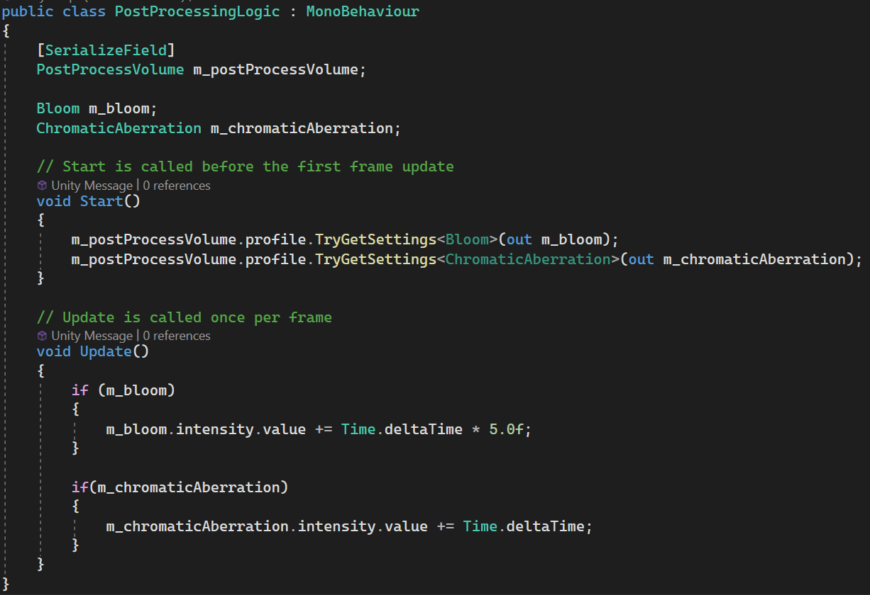
Updating Post-Processing real-time
Select Post Process Volume in Editor
Access Bloom & Chromatic Aberration
Increase Bloom & CA in Update

Slide 10
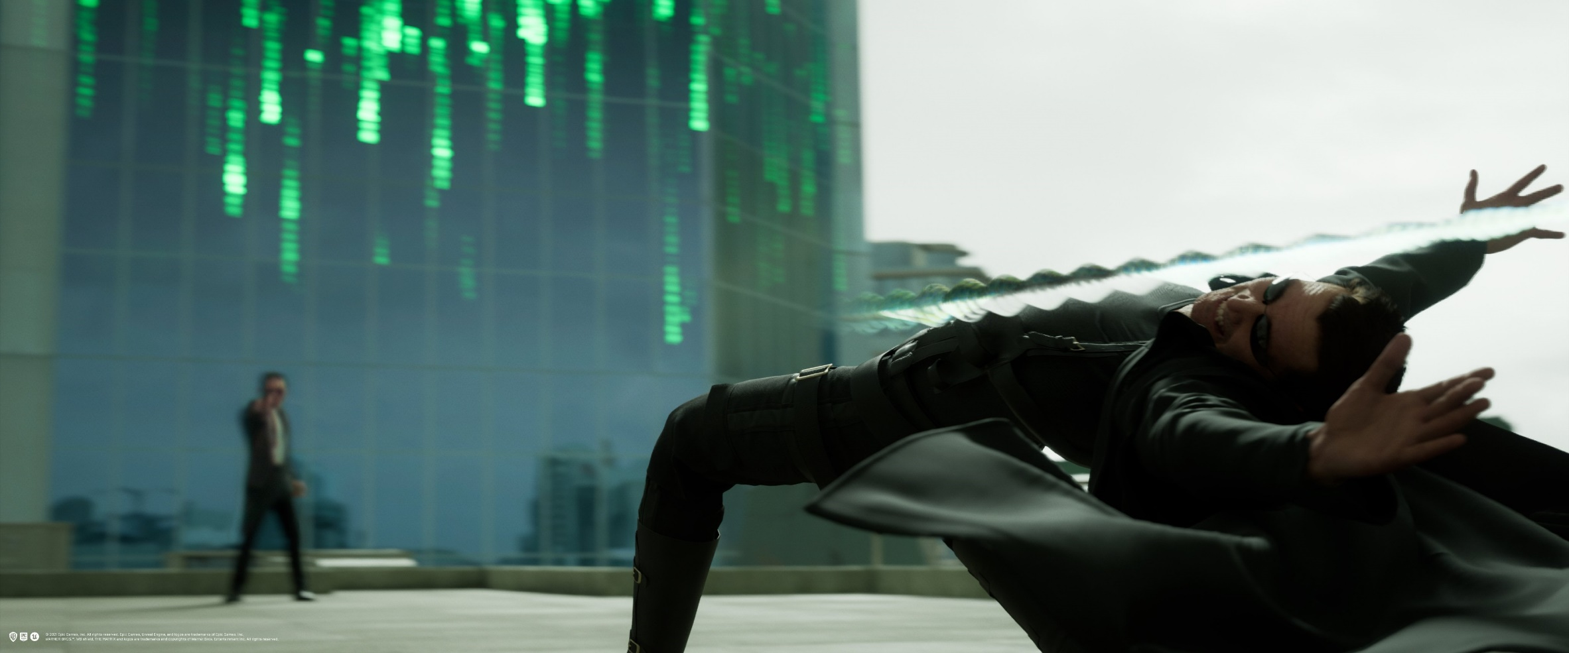
Q&A
Do you have any questions related to the topics mentioned?

