Slide 1
Cinematic Studies
Making a Horror movie

Slide 2
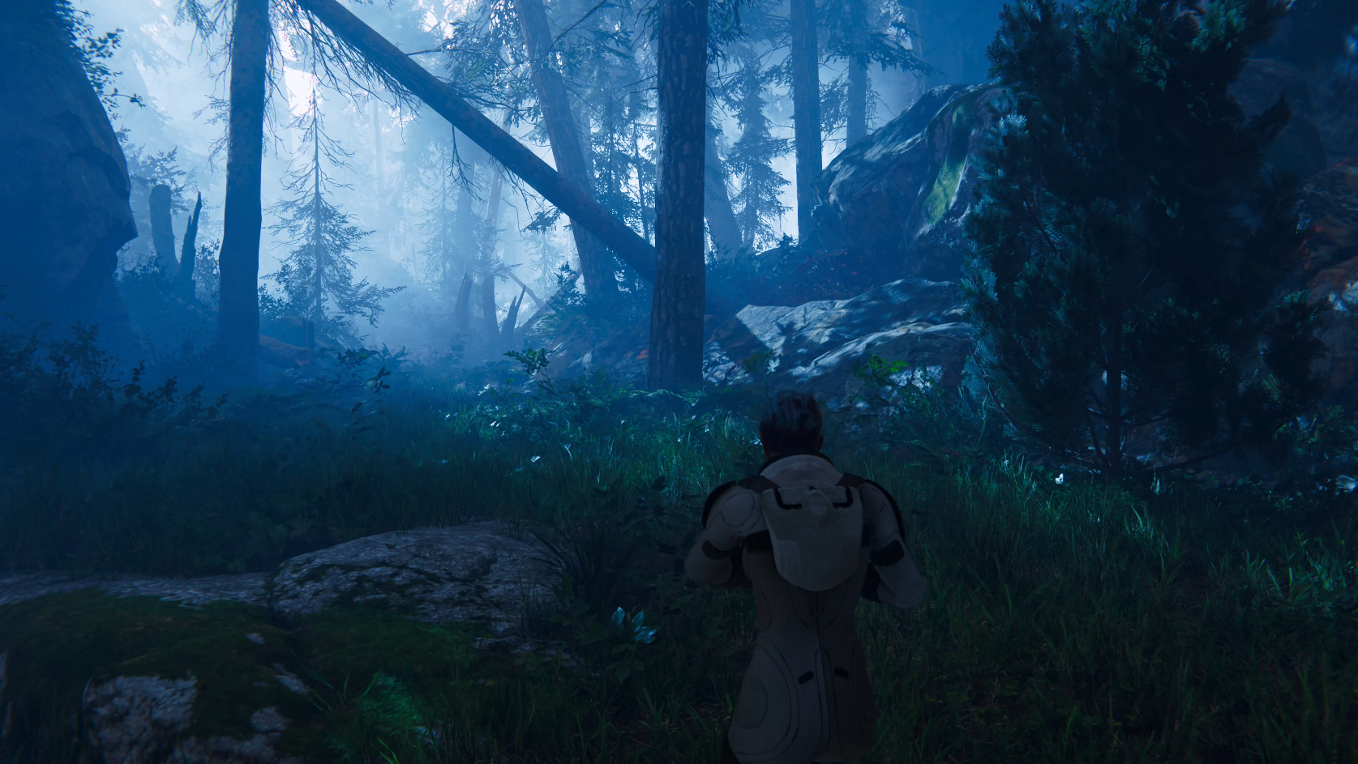
Class overview
“Crashed in the Forest” video series analysis
Idea & story discussion
Unity Package & Plugins analysis
Character walking on uneven surface
Character AI navigation
Project safety & backing up
“Crashed in the Forest” Project review
Q&A

Slide 3
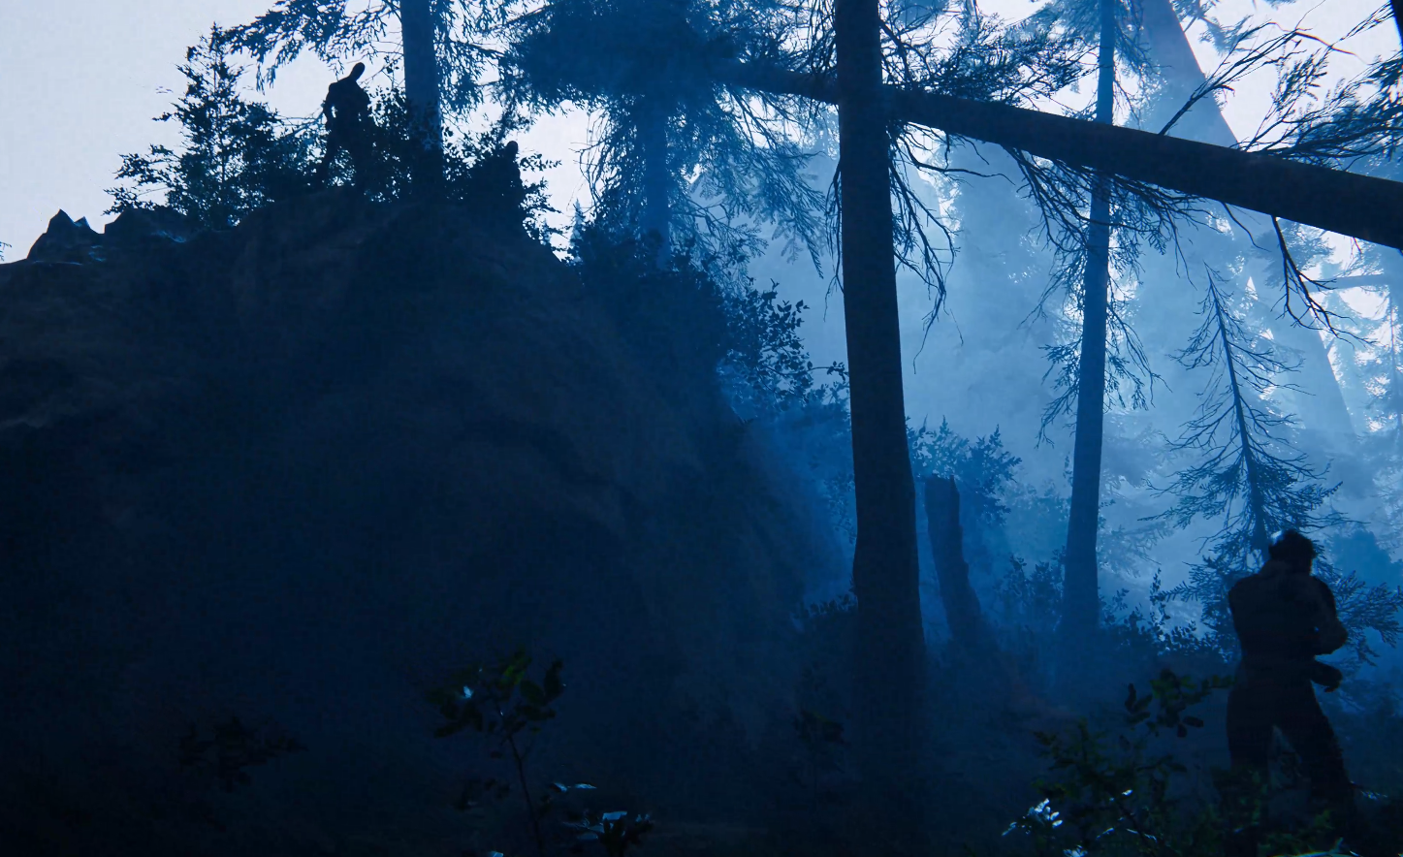
“Crashed in the Forest” video analysis
Discuss the video
How many characters?
How many animations?
How many cameras?
Which camera setups and transitions?
How is the lighting setup / post-processing?
What’s the atmosphere and feeling?
Does the music match the video?
How many sound effects?

Slide 4
Idea & story discussion
Share your ideas and stories
Let’s discuss & learn

Slide 5
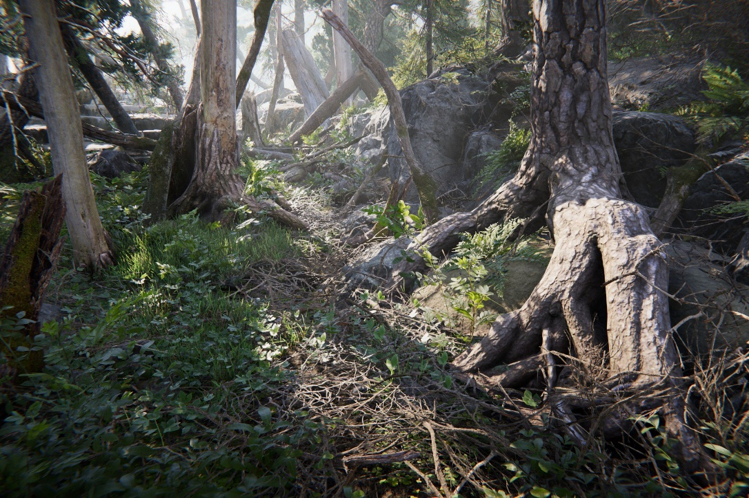
Unity Package & Plugins analysis
Book of the Dead has amazing vegetation and lighting / post-processing setup (HDRP)
Adam character pack has no animations, using default rendering
Heretic VFX character requires specific Unity version, BREAKS Book of the Dead
Particle Effects contains many useful VFX
The Courtyard – Untested
Enemies – Untested
Lighting Optimization – Untested
Unity Terrain HDRP – Untested
Be careful when importing packages!!!

Slide 6
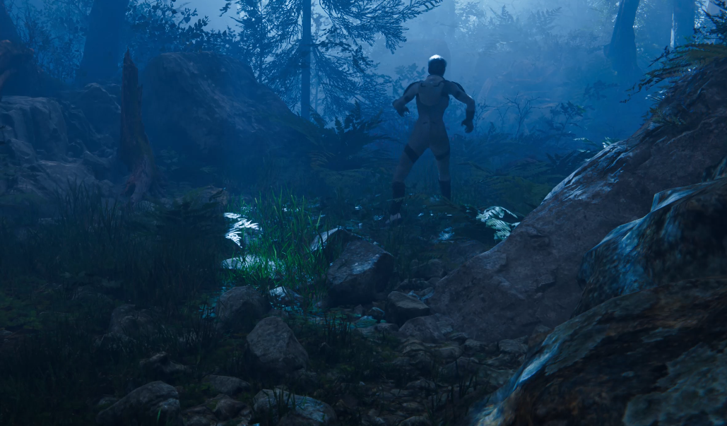
Character walking on uneven surface
Attach a PlayerController to the character and set up settings correctly
Characters can then walk on an uneven surface
“There is a difference between pressing Play and Timeline”
Yes, there is.

Slide 7
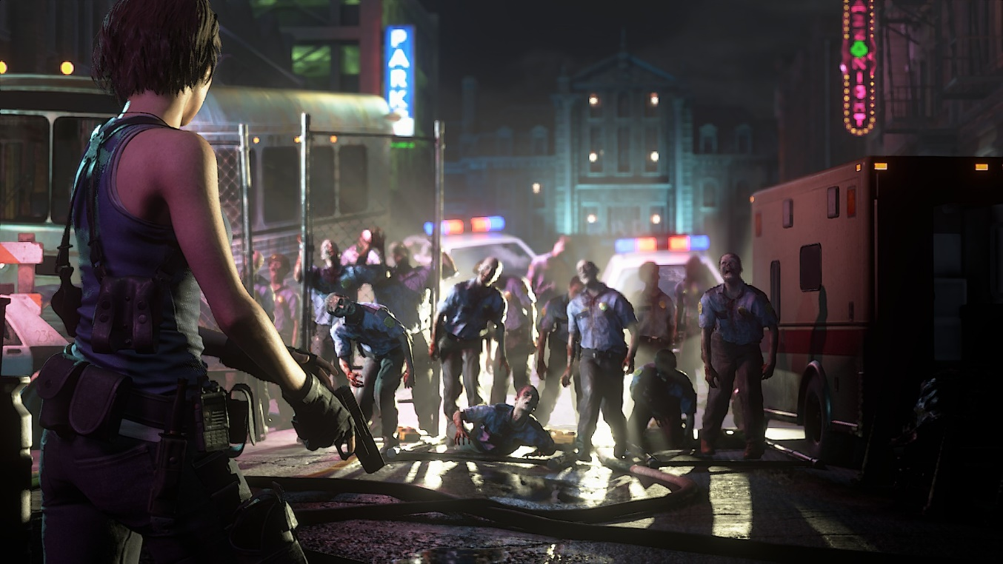
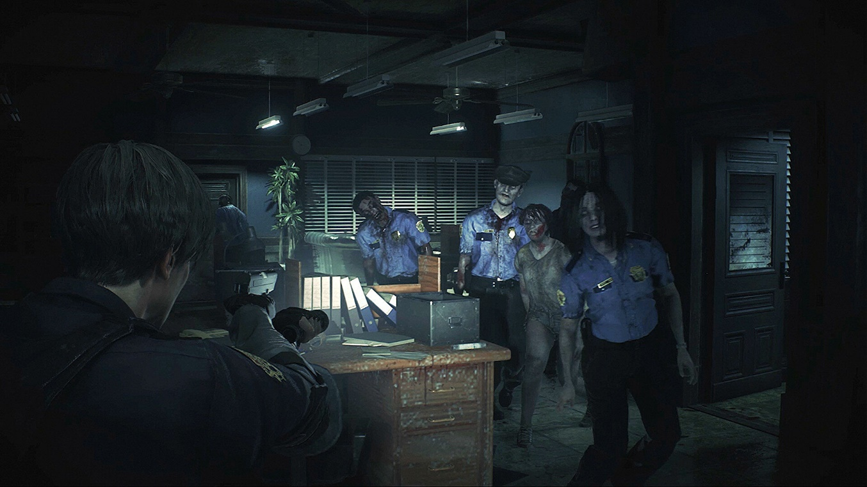
Character AI navigation
By baking a NavMesh and using NavMesh agents you can automate navigation
Obstacles will be avoided
Imagine a horde of zombies running after the character and avoiding obstacles

Slide 8
Project safety & backing up
SourceTree and Bitbucket are free!
Using Source Control you can make back-ups of your work
If you don’t want to use Source Control create back-ups!
Create back-ups before importing Packages always!!!
Create back-ups before making big or risky changes

Slide 9
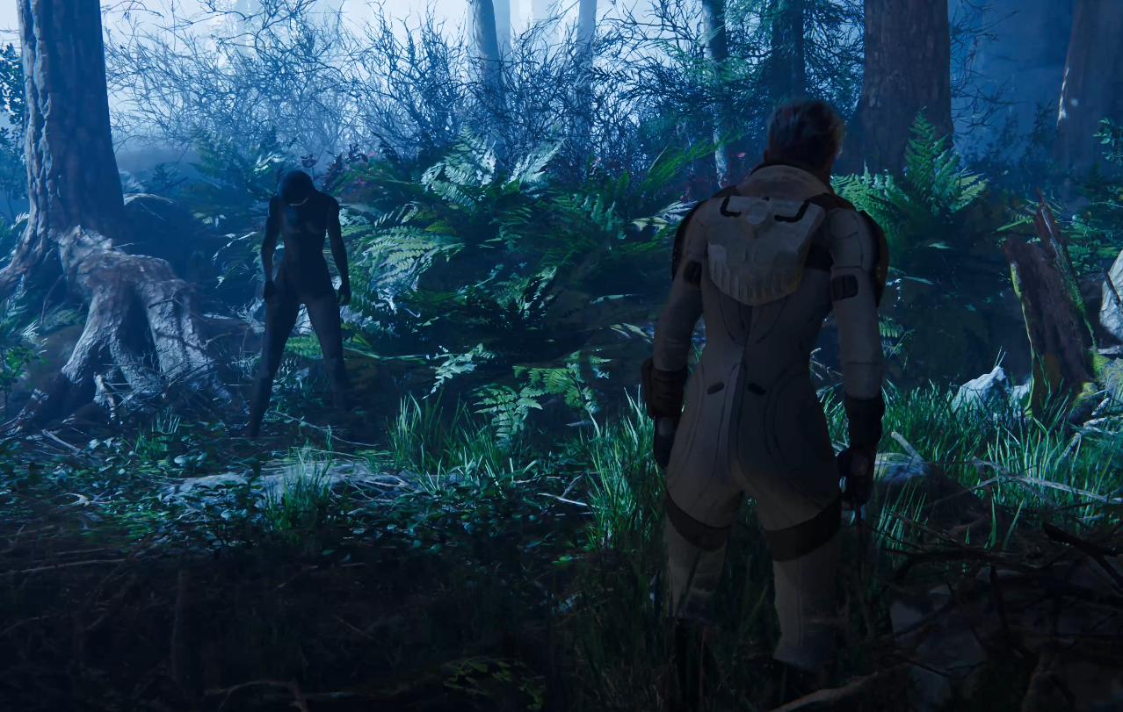
“Crashed in the Forest” Project review
Copy the Project to your hard-drive
Open the Project
Inspect the setup made for:
Timeline
Cameras
Characters
Lighting
Post-Processing
Experiment and extend

Slide 10
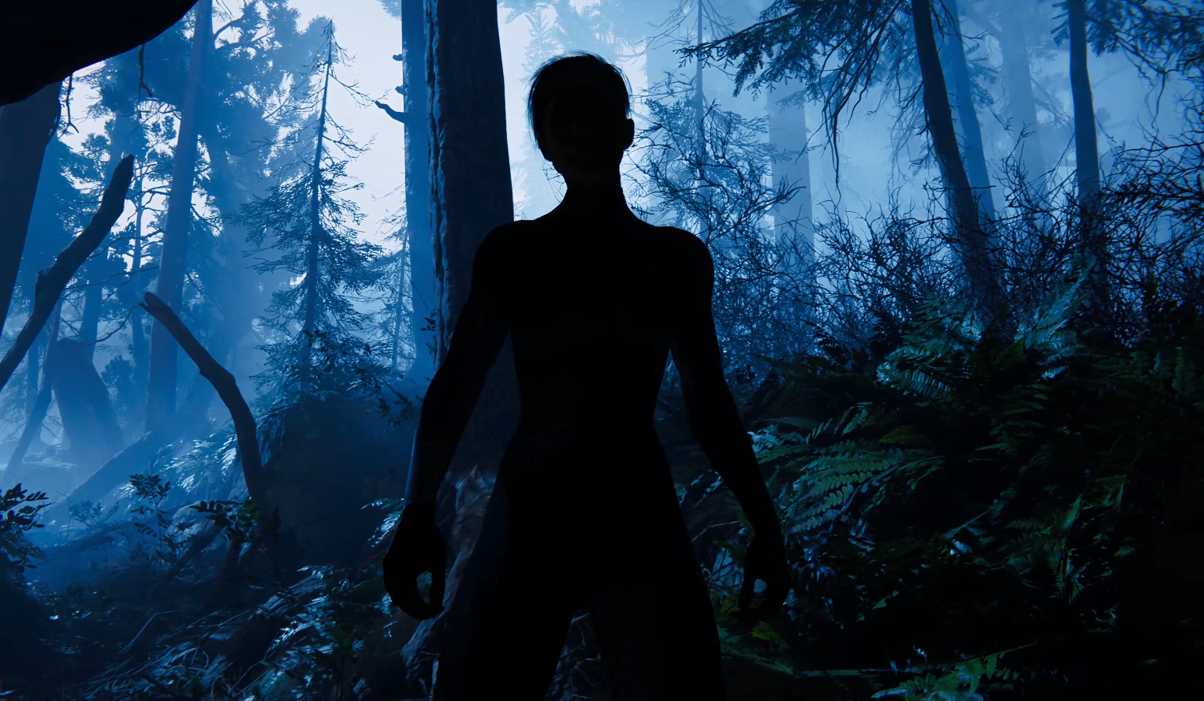
Q&A
Do you have any questions related to the topics mentioned?

